Slide 1
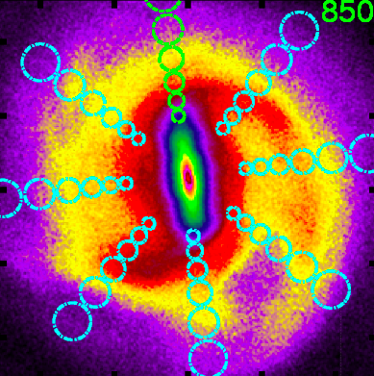
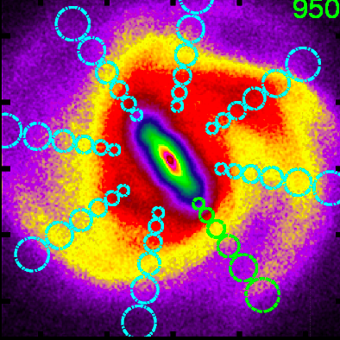
Dynamical Structures in the Galactic Disk
at solar neighborhood like location with correct angle w.r.t. bar
Hipparcos velocity distribution
Alice Quillen
U Rochester
Collaborators:
Ivan Minchev, Borja Anguiano,
Elena D’Onghia, Michaela Bagley,
Sukanya Chakrabarti, Justin Comparetta,
Jamie Dougherty …..
Notes:
List of movies:
d_anim_extend.mov
rm_movie_small.mov
page.mov
peanut movies!
clustermovie.gif
lb.mov

Slide 2
The velocity distribution of stars near the Sun
not very much information
velocity ellipsoid
Is there structure in the velocity distribution?
Tangential velocity, v
Radial velocity, u

Slide 3
The local velocity distribution (Hipparcos)
In solar neighborhood Hipparcos observations
(Dehnen 98)
Coma Berenices group
Sirius group
Tangential velocity, v
Pleiades group
Hercules stream
Radial velocity, u
Hyades stream

Slide 4
The Decade of Galactic Surveys
SDSSIII
APOGEE 150000 stars H-band, into the Galactic plane
SEGUE 1,2 250,000 stars variety of latitudes, visible
LAMOST
galactic anticenter, spectroscopic survey > million stellar spectra
GAIA (~billion stars)
all sky, proper motions, parallaxes, radial velocity and spectra
Release summer 2016, Hundred Thousand Proper Motions
Early 2017, Five-parameter astrometric solutions 90% sky, radial velocities
3rd,4th releases, classification, binaries, variables, spectra

Slide 5
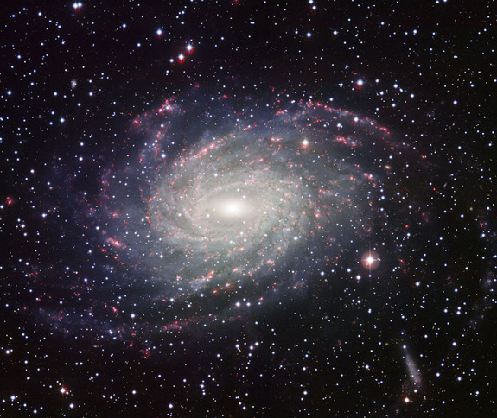
The Decade of Galactic surveys

Slide 6
Dynamical Processes affecting local velocity distributions of stars
Resonances with spiral or bar
Resonances are often narrow, so when identified they give a strong constraints → Precision measurements become possible
Resonant trapping and crossing, migration
Constraints on evolution and growth of patterns
Phase wrapping in disk
Giving clues to ages since disturbances such as mergers
Wobbly galaxy?
Cluster dissolution
Dominant heating and disrupting processes, patterns of star formation
Multiple patterns and waves
Migration, patterns of star formation, mode coupling, energy transport, heating

Slide 7
Interpreting the U,V plane u=radial v=tangential velocity components in a particular location (solar neighborhood)
Coma Berenices group
On the (u,v) plane (r is fixed) the epicyclic amplitude is set by a²~u²/2+v²
The guiding or mean radius is set by v, set by angular momentum
Orbit described by a guiding radius and an epicyclic amplitude

Slide 8
uv plane vs orbital elements
mean radius r_{g}
epicyclic angle φ
pericenter
v tangential
circular
orbits
epicyclic amplitude, a
at apocenter
u radial velocity (km/s)

Slide 9
uv plane
mean radius r_{g}
orbits with high angular momentum coming into solar neighborhood from outer galaxy
pericenter
angular momentum
circular
orbits
orbits with low angular momentum coming into solar neighborhood from inner galaxy
at apocenter
radial velocity

Slide 10
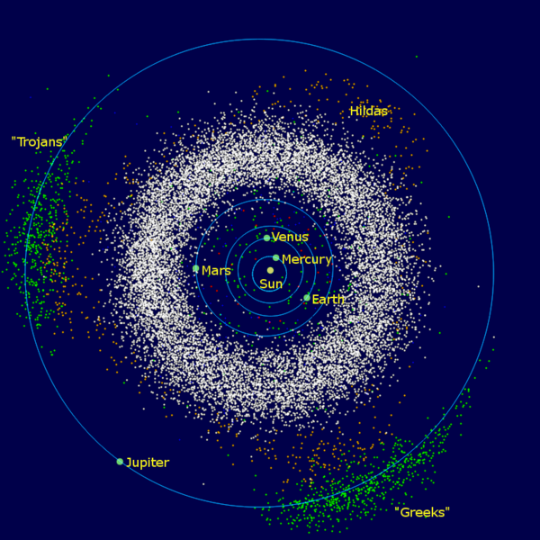
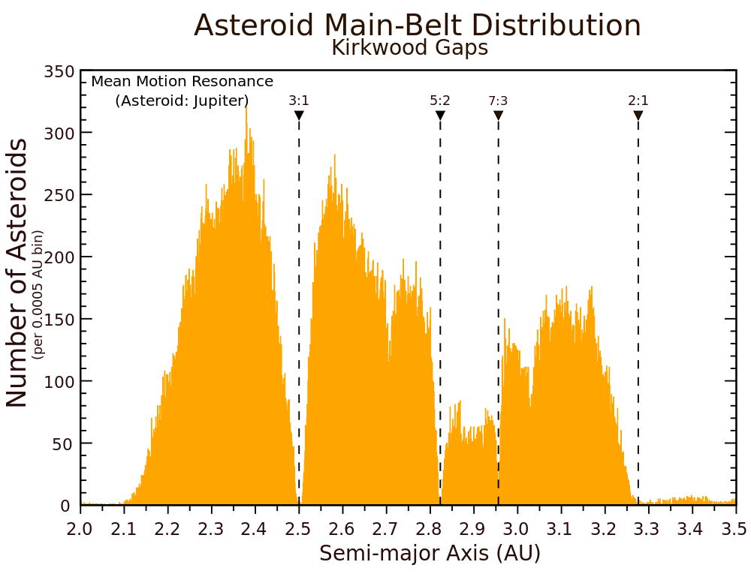
Analogy with Kirkwood gaps
asteroids in the inner solar system
no gaps
gaps!
Sun
Jupiter
Resonant gaps with Jupiter are not clearly seen in radial distribution but are clearly seen in the semi-major axis distribution
Semi-major axis sets orbital period
In the Solar neighborhood the angular momentum (v velocity component) sets the orbital period and so the location of resonances

Slide 11
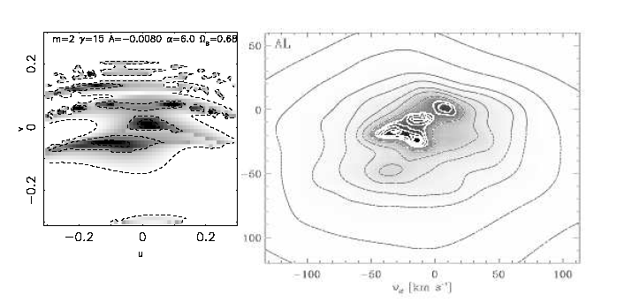
Interpreting the UV plane with resonances
The orbital period is set by v, the tangential velocity component
Resonance with the bar is crossed
Gap due to Outer Lindblad resonance with Bar (e.g., Dehnen 2000)
Analogy in celestial mechanics: the orbital period is set by the semi-major axis
Hipparcos velocity distribution
tangential velocity v
Hercules stream
Radial velocity

Slide 12
Directions correspond to points in the uv plane
In this neighborhood there are two different velocity vectors
At the resonant period orbits are divided into two families
There are no orbits with intermediate velocity vectors
tangential velocity v
bar
Hercules stream
Radial velocity u

Slide 13
Gaps in different neighborhoods
Precision measurements
Resonances are narrow (scales with perturbation strength) → Tight constraints from their location
Gardner & Flynn 2010, Minchev et al. 2007 measured the Bar pattern speed
Inside the solar neighborhood
closer to the 2:1 Lindblad resonance with Bar
Outside the solar neighborhood
more distant from the resonance with Bar
→ There should be a shift in the location of the gap dividing the Hercules stream

Slide 14
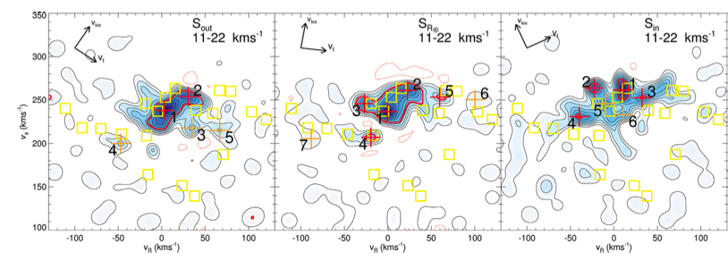
Local Velocity Distributions show a shift in the location of the gap
at larger radius
solar neighborhood
at smaller radius
Tangential velocity v
RAVE data
Antoja et al. (2012)
Radial velocity u

Slide 15
Summary
location in UV plane can be interpreted in terms “orbital elements”
Features in velocity distribution can be due to resonances with bar/spiral structure
Precision measurements, predictions for structure with position in Galaxy

Slide 16
What will we see in other neighborhoods?
How can we use larger, deeper datasets that will become available with GAIA and LAMOST to constrain models?
Look at local velocity distributions in an N-body simulation
Numerically now feasible
Look for signature of resonances
Try to understand relation between velocity distributions and spiral and bar structures

Slide 17
Simulations of a Milky-Way-like Galaxy
Only disk particles are shown.
Halo is live, center of bulge moves
Lopsided motions
Milky Way model
+extra massless tracer particles
Phi-grape on GPU
Thanks to Micaela Bagley
Notes:
movie: d_anim_extend.mov

Slide 18
In polar coordinates
logarithmic spirals on top are slower than bar on the bottom
Constructive and destructive interference between patterns
Notes:
movie: rm_movie_small.mov

Slide 19
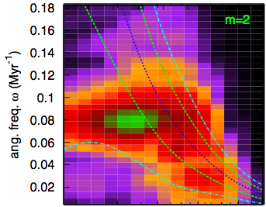
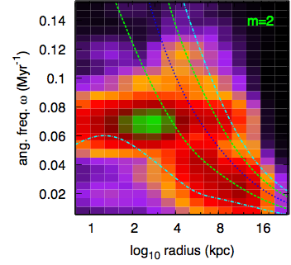
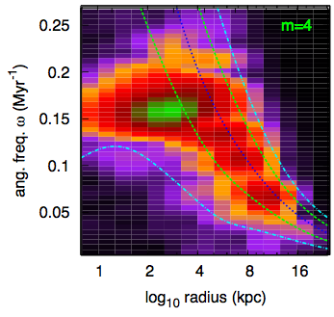
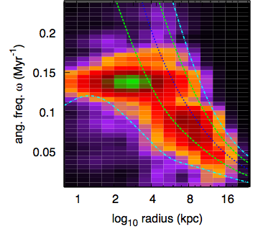
Spectrograms: mid and late simulation
early
m=2
power as a function of frequency
m=2
late
angular frequency
early
m=4
late
m=4
Bar is slowing down. Similarity of spectrograms at different times during simulation implies that waves are coupled.
log₁₀ radius(kpc)

Slide 20
Local neighborhoods
velocity distributions
v→
u→
cartesian coordinates
polar coordinates

Slide 21
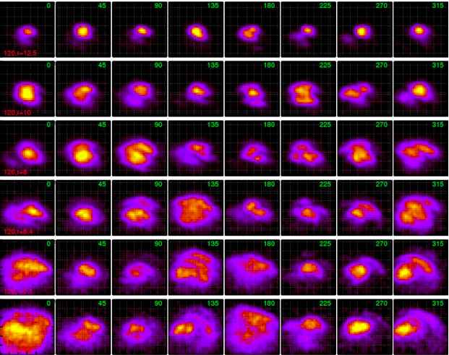
Local velocity distributions
u
r₀=12.5
v
r₀=10
r₀=8
radius
r₀=6.4
r₀=5.1
r₀=4.1
angle w.r.t. bar

Slide 22
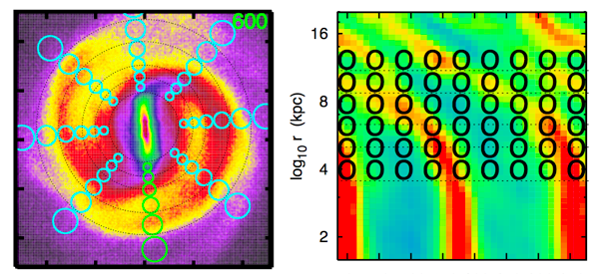
Comments on the local velocity distributions
Low dispersion inter-arm
Higher dispersions and arcs on arm peaks
Gaps, arcs and clumps everywhere in the galaxy
Gaps from bordering neighborhoods tend to be at shifted v velocities.
v sets angular momentum so mean orbital radius

Slide 23
Discontinuities in spiral structure
relation between orientation vectors and velocity distribution

Slide 24
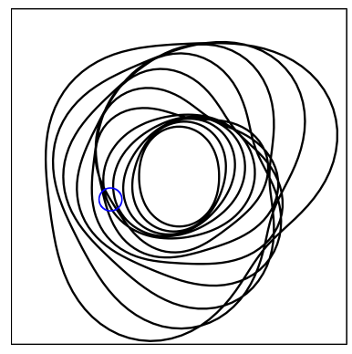
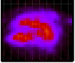
Discontinuities in spiral structure when multiple waves are present
Armlets
Kinks or bends in spiral arms
Manifest in velocity distributions as gaps
2 armed inner + 3 armed outer pattern

Slide 25
at solar neighborhood like location with correct angle w.r.t. bar
picking times with velocity distributions like the solar neighborhood’s
Hipparcos velocity distribution
Bob Hurt’s cartoon

Slide 26
Local velocity distribution does not strongly constrain structure on the other side of the Galaxy
≠
3 armed structures should be considered for the Milky Way, near the Solar neighborhood

Slide 27
Interference between waves
Spiral arm features appear and disappear
Bursts of star formation can appear and move across the galaxy
Star formation as a tracer for variations in spiral structure

Slide 28
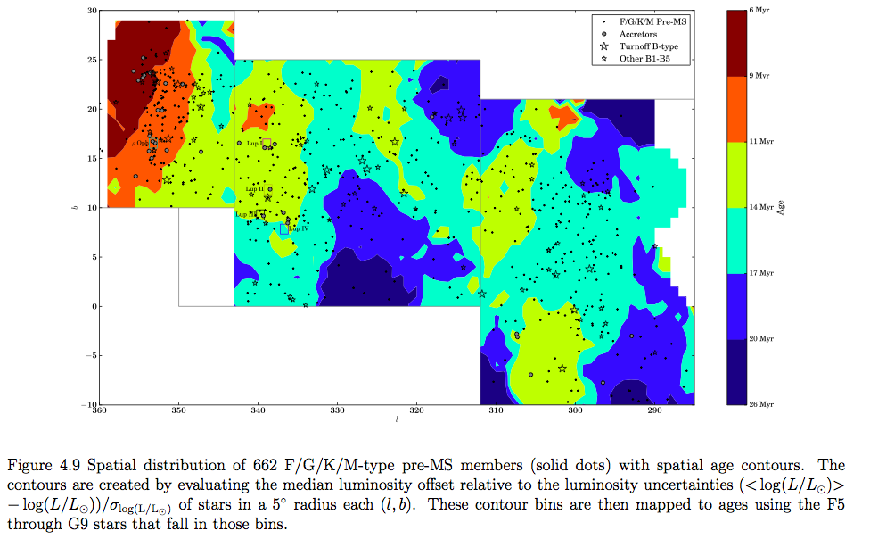
Pattern of Star formation in the Sco-Cen OB association
age
30
young
6Myr
Mark Pecaut PhD thesis 2013
9Myr
Upper Scorpius
145 pc
Upper Centaurus
Lupus 142 pc
11Myr
galactic latitude (b)
14Myr
Lower Centaurus Crux 118 pc
17Myr
50pc
Moving groups!
20Myr
-10
older
26Myr
360
galactic longitude (l)
290

Slide 29
330
300
Armlet or spur?
Sco Cen

Slide 30
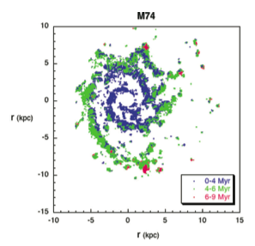
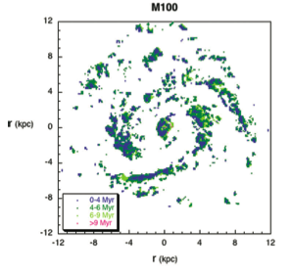
Patterns of Star Formation
Sanchez-Gil et al.(2011)
1 kpc/Myr corresponds to 1000 km/s and is unphysical
Velocity gradient between old and new stars should be r(Ω-Ω_{p}) and so should lie below circular velocity 200km/s = 0.2kpc/Myr

Slide 31
Patterns of Star Formation
Sanchez-Gil et al.(2011)
Resolved gradients can be due to growth/disappearance of spiral features or multiple pattern interference, or external perturbations, not single patterns

Slide 32
Migration by local transient peaks
Stars in phase with a local density peak drift inward or outward (depending on phase)
Single patterns at corotation? No.
Multiple patterns and short lived interference giving local density peaks that cause stars to migrate
Many more transient peaks thank patterns during lifetime of Galaxy

Slide 33
Summary
N-body simulations show phase space structure everywhere
Gaps related to transitions between patterns
Interference in different patterns can cause bursts of moving star formation and stellar migration
3-armed/lopsided/bar coupling?

Slide 34
Dissolution of a cluster

Slide 35
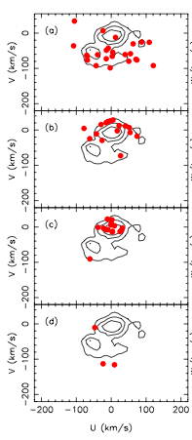
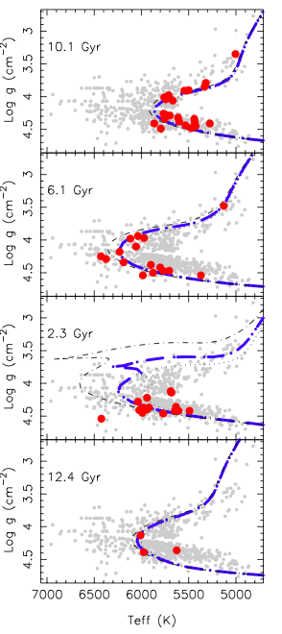
Abundance groups in the solar neighborhood
10.1 Gyr
log g (cm s⁻²)
6.1 Gyr
Blind chemical tagging experiment
2.3 Gyr
Mitschang et al. 2014
12.4 Gyr
Mitschang et al. 2014, using Bensby et al.2014 sample of 714 stars
V (km/s)
U (km/s)
Teff (K)

Slide 36
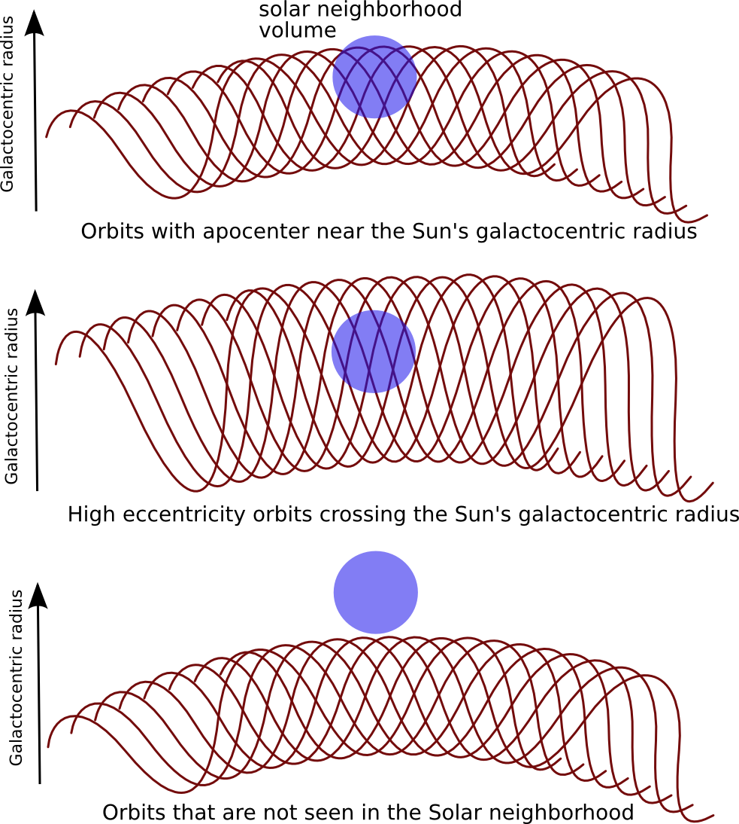
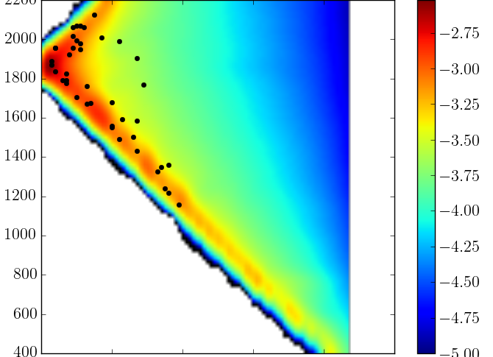
probability of finding a star in the solar neighborhood assuming even distribution
Angular Momentum
log₁₀ probability
4.8 Gyr
Angular Momentum
log₁₀ probability
10.2 Gyr
Eccentricity

Slide 37
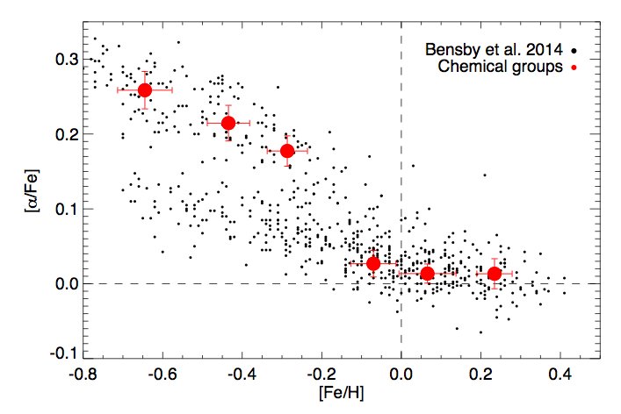
6 largest groups
thick disk
thin disk

Slide 38
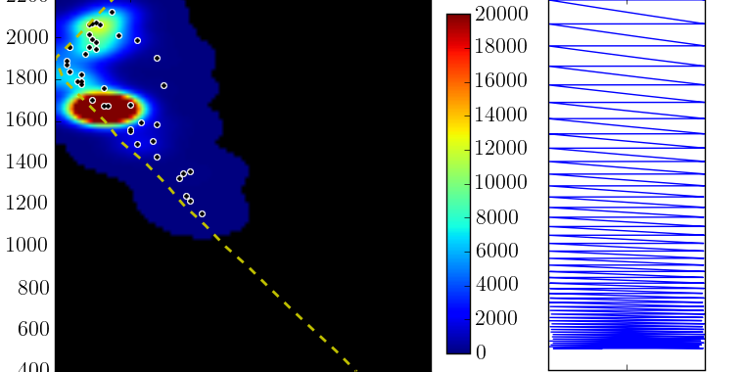
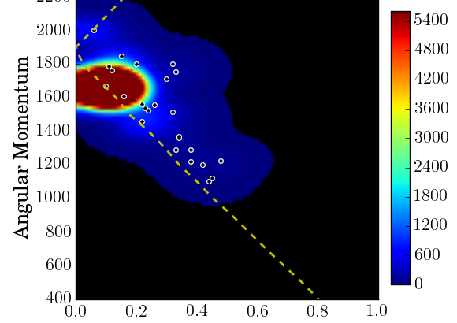
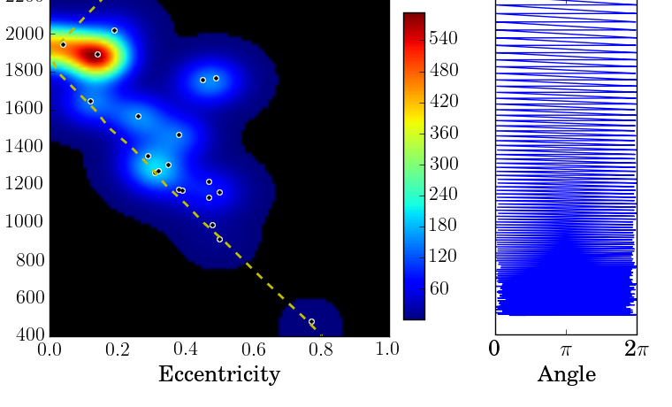
Parent populations of the 6 largest abundance groups
are these groups evenly distributed?
4.8 Gyr
Angular Momentum
12.1Gyr
7.1Gyr
Angular Momentum
Angular Momentum
Eccentricity
Eccentricity
Angle

Slide 39
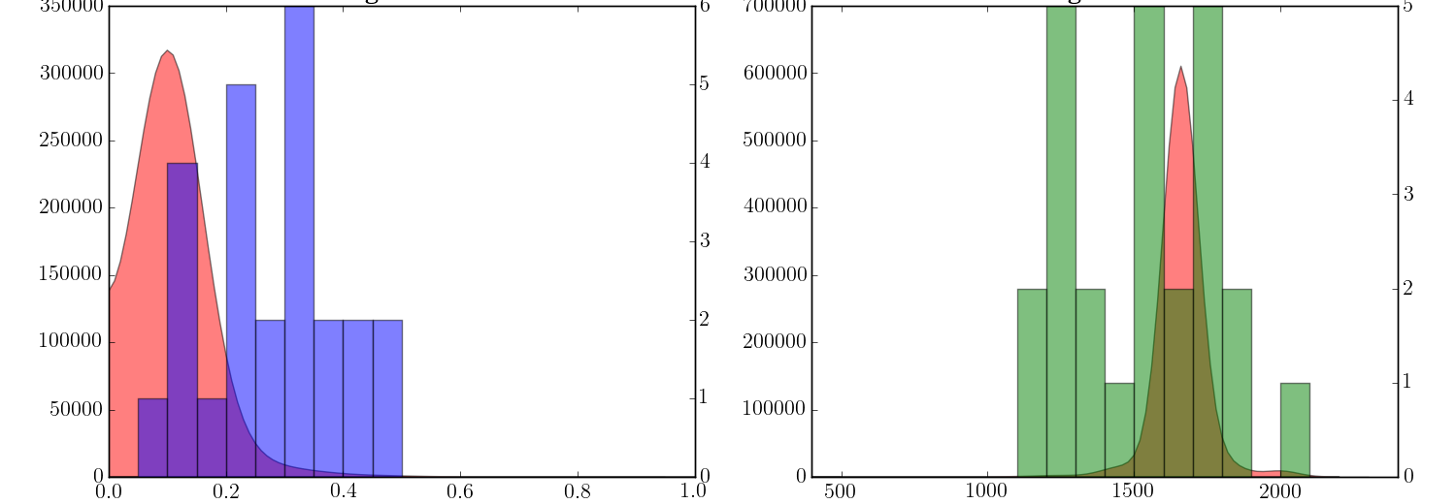
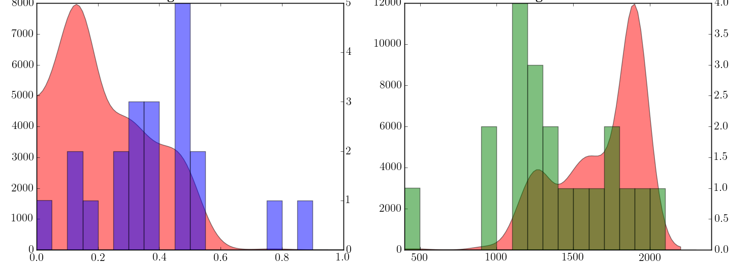
Parent populations
7.1 Gyr
7.1 Gyr
Sizes:
300,000--4 million
Conatal?
Coeval?
parent
group
parent
group
number of stars
12.1 Gyr
12.1 Gyr
parent
group
parent
group
eccentricity
angular momentum
Thin disk groups: narrow distributions in e,L
→ little migration/heating
Thick disk groups: wide distributions
→ lots of migration/heating

Slide 40
Summary
Parent populations for mono-abundance groups of nearby stars are too large to be birth clusters (unless the parent populations are unevenly distributed)
If they are co-eval then constraints on migration/heating
Sample completeness ….

Slide 41
Post Impulse Disk Response
Vertical epicyclic motions
Radial epicyclic motions
test particle simulations

Slide 42
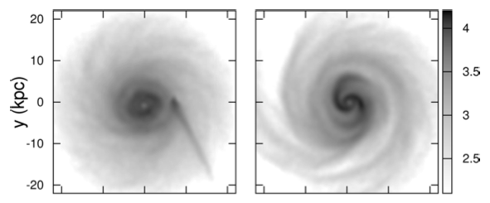
0Myr
250Myr
Density
Widrow et al. 2014 simulations

Slide 43
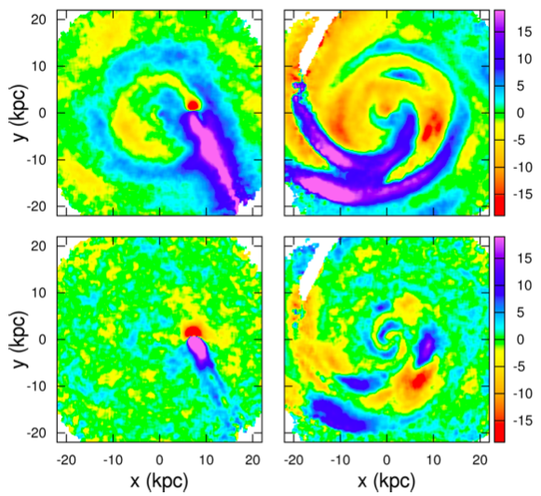
0Myr
250Myr
<v_{z}>
<v_{z}>
250Myr
0Myr
<dv_{z}/dz>
<dv_{z}/dz>

Slide 44
0Myr
250Myr
<v_{z}>
<v_{z}>
0Myr
250Myr
<dv_{z}/dz>
<dv_{z}/dz>

Slide 45
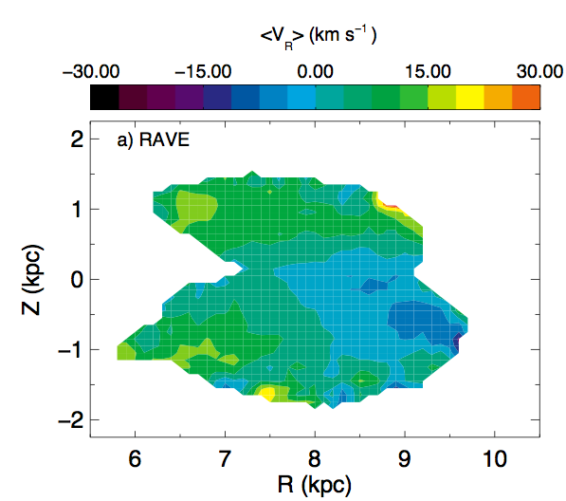
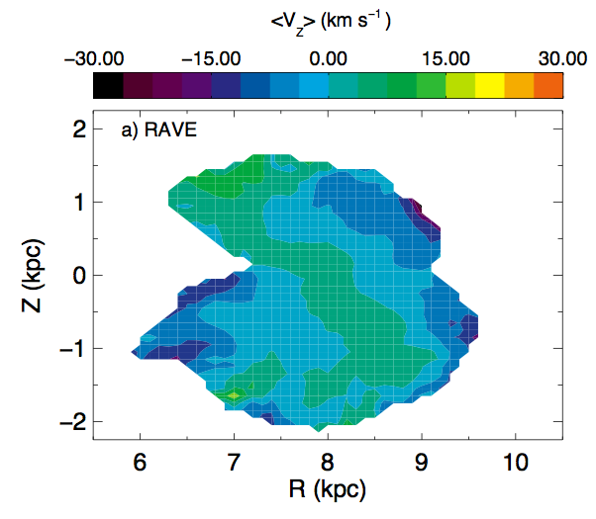
Gradients with height in the solar neighborhood
Wobbly galaxy (Williams et al. 2013)

Slide 46
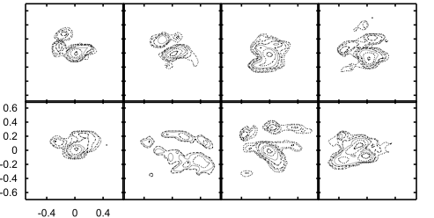
Disk perturbed by a low mass satellite passing through the outer Galactic disk
v
u
streams induced over short timescales as well as heating and mixing
(Quillen et al. 2009)

Slide 47
Phase wrapping
→
V_{R}
R →
Two settings:
Minor merger debris originates in a particular region in phase space
Background galaxy is perturbed resulting in an uneven distribution in phase space

Slide 48
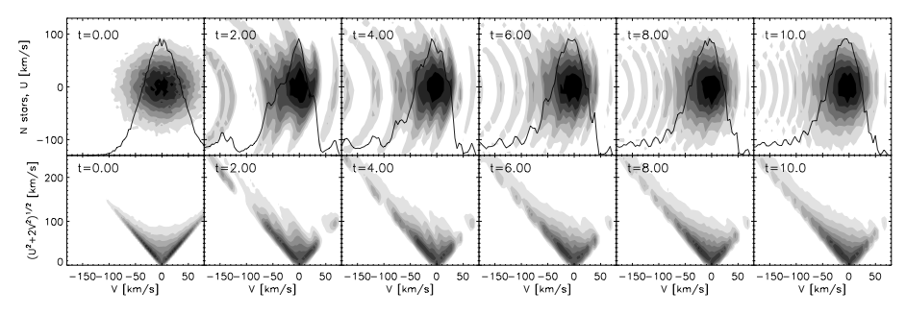
Phase wrapping in the disk
following uneven distribution in epicylic oscillation angle, the thick disk can exhibit streams (Minchev et al. 2009)
u
v
time
Semi-analytical model constructed by weighting with epicyclic angle

Slide 49
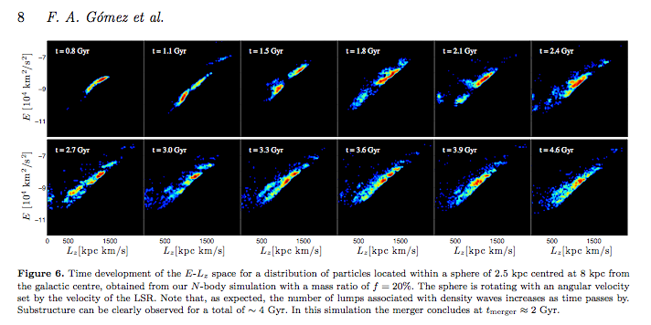
Signature of a minor merger in the distribution of disk stars in an N-body simulation
Substructure in E/L persists for 2 Gyr after merger
Gomez et al. (2011)

Slide 50
Summary
Perturbations from external galaxies, minor mergers →
clumps in phase space (relaxation)
mixing and heating in outer Galaxy
gradients in velocity field from epicyclic perturbations

Slide 51
Summary/Conclusion
Beautiful rich dynamics implies that we will continue to discover sub-structure in large scale surveys of the Galaxy disk
Prospects of precision measurements as well as constraints on past evolution
Opportunities to measure morphology and constrain dynamical processes

Slide 52
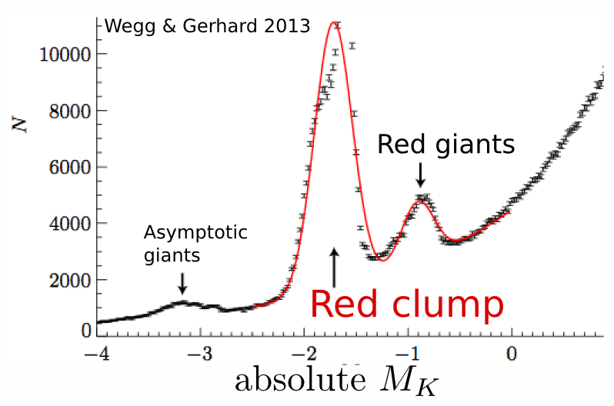
3D structure of the Milky Way Bulge
Photometric surveys of the Galactic bulge
Deconvolving luminosity distributions at different positions on the sky
each panel at a different latitude
10
5kpc
Using VVV survey (like 2MASS only deeper) Wegg & Gerhard 2013

Slide 53
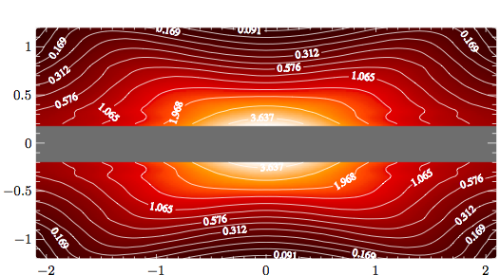
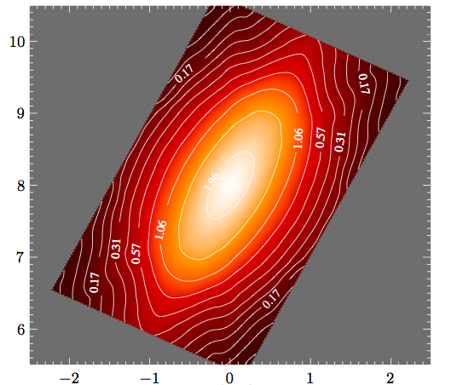
Milky Way not only barred but has an X- or peanut-shaped bulge Galaxy (discovery: Nataf et al. 2010, Williams & Zoccalli 2010)
from the side
3D Models of the Milky Way bulge by
Wegg & Gerhard 2013
z(kpc)
from the side
x (kpc)
y (kpc)
from above
x(kpc)

Slide 54
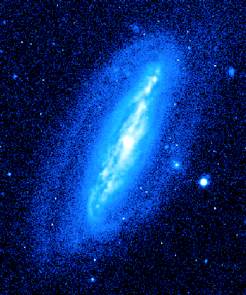
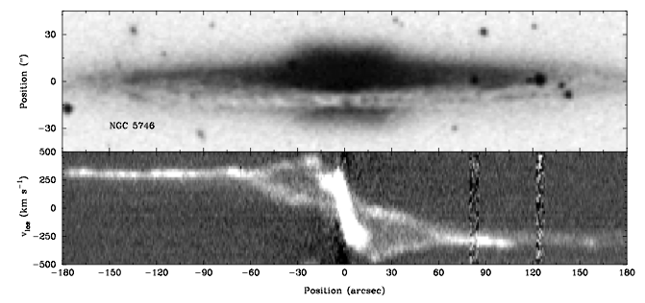
In rare inclined cases both bar and peanut
are seen NGC7582
(Quillen et al. 1997)
NGC 7582
B band
Velocities measured spectroscopically imply that all peanut-shaped galaxies are barred (Martin Bureau’s 98 thesis)
→ Peanut shape is a barred galaxy phenomenon
K band
isophotes
Bureau ‘98
velocity position
spectrum

Slide 55
N-body simulations (GALMER database)
Notes:
ivan’s movies

Slide 56
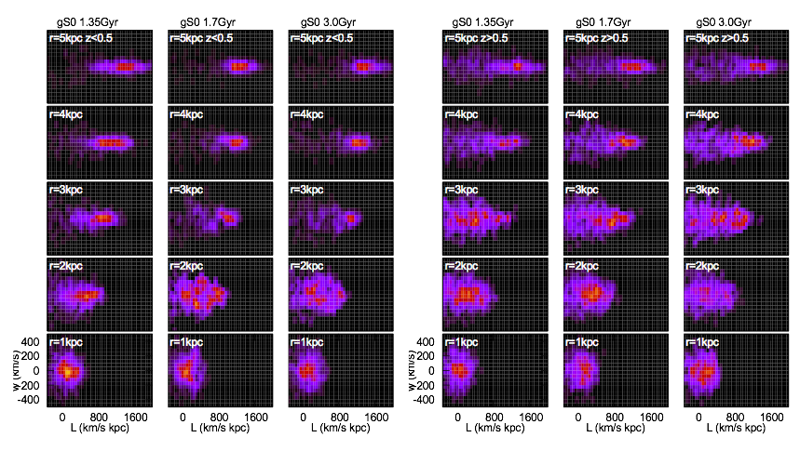
Local Velocity distributions
panels = time→
measured in N-body simulation
z<0.5 kpc
z>0.5 kpc
panels = radius →
missing
missing
missing
hot!
hot!
hot!
vertical velocity
angular momentum →
angular momentum →
no cold stars in the plane below a particular angular momentum value

Slide 57
What do we seen in simulations?
Bars slow down
Some bars buckle, others do not
Peanut-shape keeps growing after bar buckling phase – while galaxy is vertically symmetric
Within a particular angular momentum value, stars are heated vertically
Absence of cold populations within boundary
Resonance is more important than previous bar buckling?
(though bar buckling can increase disk thickness and so decrease the vertical oscillation frequency)

Slide 58
Vertical resonance
Commensurability between vertical oscillations and rotation in frame of bar
Vertical 2:1 Lindblad resonance
Integrate this
resonant angle
Fixed for periodic orbits
Banana shaped orbits
BAN+
BAN-
distance to resonance,
is a fast frequency if far from resonance

Slide 59
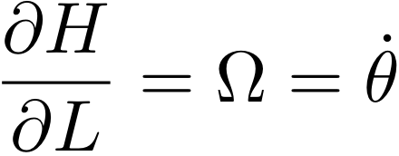
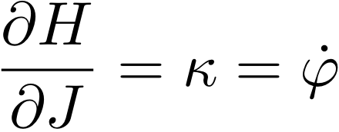
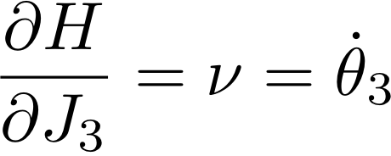
Hamiltonian Model for an axi-symmetric system
vertical frequency
angular rotation rate
epicyclic frequency
rotation
Hamilton’s equations
epicyclic motion
vertical motion
Hamiltonian is independent of angles → L,J, J₃ conserved
With a better approximation H₀ depends on J², J₃²

Slide 60
Hamiltonian model for banana orbits
from unperturbed Hamiltonian
bar perturbation
distance to resonance
a frequency that
depends on radius
resonant angle
bar strength
Fourier components with fast angles can be neglected via averaging
Hamiltonian then only contains one angle, so can perform a canonical transformation and reduce to a one dimensional system

Slide 61
Vertical resonances with a bar
Orbits in the plane
Increasing radius
Banana shaped periodic orbits
Level curves of Hamiltonian in a canonical coordinate system with
orbits in midplane are near the origin
Orbits in the plane

Slide 62
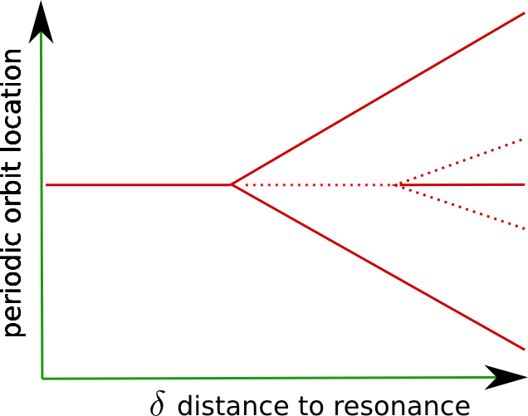
Bifurcation of periodic orbits
BAN+
orbits in plane
BAN-
Martinez-Valpuesta et al. 06
Jacobi integral

Slide 63
Analogy with the capture of Pluto by Neptune?
plutinos
Kuiper belt
As Neptune moves outwards, Pluto’s eccentricity increases
As the bar grows and slows down and the galaxy thickens, captured stars increase in height
eccentricity
Wm. Robert Johnston
semi-major axis

Slide 64
Resonant capture?

Slide 65
Resonant capture?
Unfortunately bar slowing goes this way

Slide 66
Fate of stars exterior to resonance
As the bar slows down, stars stars originally in midplane are pushed into resonance
These are lifted into orbits near the resonance separatrix
Then they cross the separatrix but remain at high inclination
Only stars in orbits near the separatrix will be aligned with the bar and “support the peanut shape”
These are not near periodic orbits!
→ Resonant heating process

Slide 67
Is the X-shaped feature at the location of the resonance in the Milky Way?
We don’t know ν, so using density instead
Poisson’s equation in cylindrical coordinates
In midplane
Use the resonance commensurability
Expression for midplane density as a function of rotation curve and bar pattern speed. Should be equal to the actual midplane density in resonance
→ Constraint on mid-plane density at the location of the resonance

Slide 68
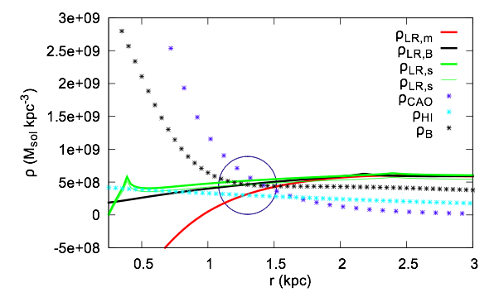
X in Milky Way, rotation curve, bar pattern speed, density estimates all self-consistent
Malhotra’s rotation curve
Besançon model rotation curve
Sofue’s rotation curve
Cao’s model
Malhotra’s HI dispersions
Besançon model density
future work can shrink this error circle

Slide 69
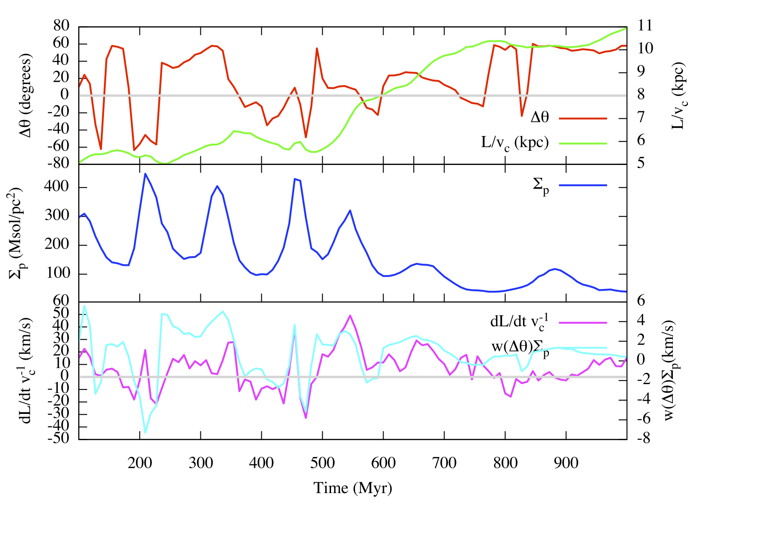
Torque well estimated by angle from nearest peak and it’s surface density

