Slide 1
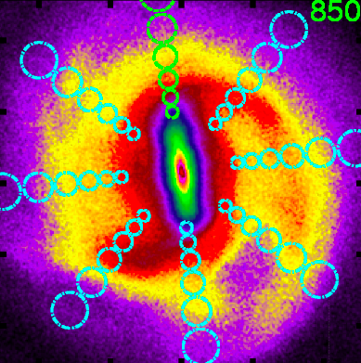
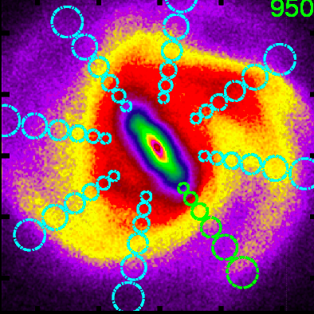
Dynamical Structures in the Galactic Disk
at solar neighborhood like location with correct angle w.r.t. bar
Hipparcos velocity distribution
Alice Quillen
U Rochester
Collaborators:
Ivan Minchev,
Michaela Bagley,
Justin Comparetta,
Jamie Dougherty
Notes:
List of movies:
d_anim_extend.mov
rm_movie_small.mov
page.mov
clustermovie.gif
lb.mov

Slide 2
Structure in the local velocity distribution
Features in the distributions of motions of the stars can reveal clues about the structure, evolution and formation of the Galaxy
Stellar velocity distribution in solar neighborhood Hipparcos
(Dehnen 98)
Coma Berenices group
Sirius group
Tangential velocity, v
Pleiades group
Hercules stream
Radial velocity, u
Hyades stream

Slide 3
Processes affecting local velocity distributions of stars (aka the phase space distribution)
Resonances with spiral or bar
Resonances are often narrow, so when identified they give a strong constraint on pattern speed → Precision measurements become possible
Resonant trapping and crossing
Constraints on evolution and growth of patterns
Phase wrapping in disk
Giving clues to ages since disturbances such as mergers
Cluster dissolution
Dominant heating and disrupting processes, patterns of star formation
Multiple patterns
Migration, patterns of star formation

Slide 4
Interpreting the U,V plane u=radial v=tangential velocity components in a particular location (solar neighborhood)
Coma Berenices group
On the (u,v) plane (r is fixed) the epicyclic amplitude is set by a²~u²/2+v²
The guiding or mean radius is set by v, set by angular momentum
Orbit described by a guiding radius and an epicyclic amplitude

Slide 5
uv plane vs orbital elements
mean radius r_{g}
epicyclic angle φ
v tangential
circular
orbits
epicyclic amplitude, a
u radial velocity (km/s)

Slide 6
uv plane
mean radius r_{g}
orbits with high angular momentum coming into solar neighborhood from outer galaxy
circular
orbits
angular momentum
orbits with low angular momentum coming into solar neighborhood from inner galaxy
radial velocity

Slide 7
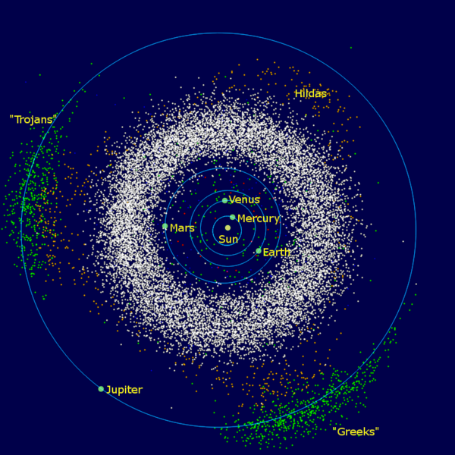
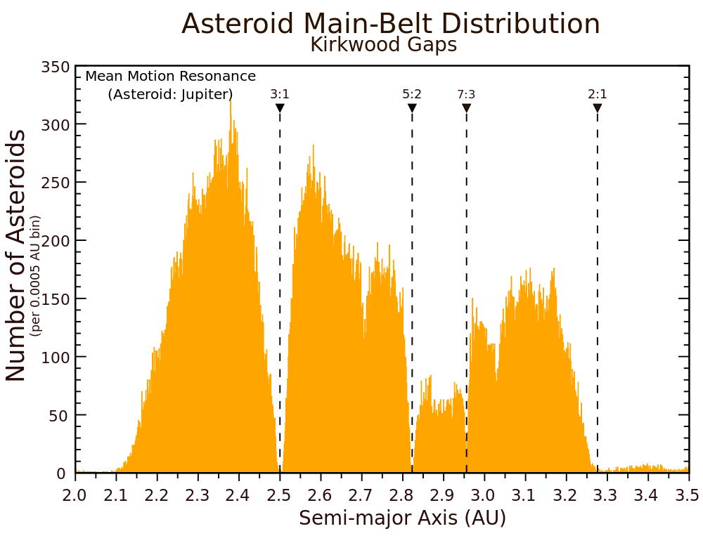
Analogy with Kirkwood gaps
asteroids in the inner solar system
no gaps
gaps!
Sun
Jupiter
Resonant gaps with Jupiter are not clearly seen in radial distribution but are clearly seen in the semi-major axis distribution
Semi-major axis sets orbital period
In the Solar neighborhood the angular momentum (v velocity component) sets the orbital period and so the location of resonances

Slide 8
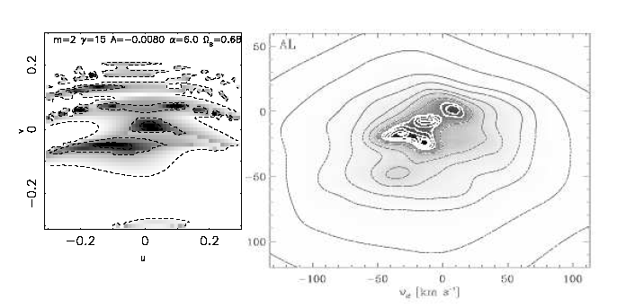
Interpreting the UV plane with resonances
The orbital period is set by v, the tangential velocity component
Resonance with the bar is crossed
Gap due to Outer Lindblad resonance with Bar (e.g., Dehnen 2000)
Analogy in celestial mechanics: the orbital period is set by the semi-major axis
Hipparcos velocity distribution
tangential velocity v
Hercules stream
Radial velocity

Slide 9
Directions correspond to points in the uv plane
In this neighborhood there are two different velocity vectors
At the resonant period orbits are divided into two families
There are no orbits with intermediate velocity vectors
tangential velocity v
bar
Hercules stream
Radial velocity u

Slide 10
Precision measurements
Resonances are narrow (scales with perturbation strength)
→ Tight constraints from their location
Gardner & Flynn 2010, Minchev et al. 2007 measured the Bar pattern speed
Also see Teresa Antoja’s poster

Slide 11
Location of resonances in different neighborhoods
Inside the solar neighborhood
closer to the 2:1 Lindblad resonance
Outside the solar neighborhood
more distant from the resonance
→ There should be a shift in the location of the gap dividing the Hercules stream

Slide 12
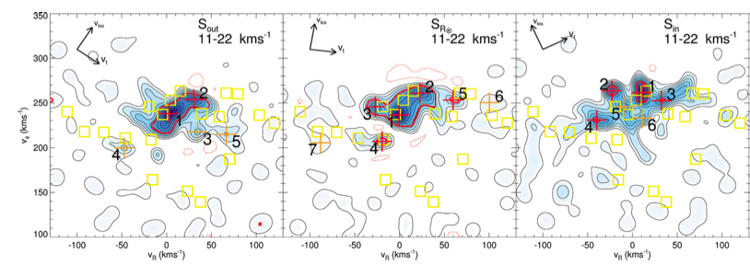
Local Velocity Distributions show a shift in the location of the gap
at larger radius
solar neighborhood
at smaller radius
Tangential velocity v
RAVE data
Antoja et al. (2012)
Radial velocity u

Slide 13
Resonances with spiral patterns could also cause gaps in the velocity distribution
v →
from Lepine et al. 2011
u →
Near the 4:1 Lindblad resonance. Regions on the u,v plane corresponds to different families of closed/periodic orbits
No nearly circular orbits exist near resonance so there is a gap in velocity distribution

Slide 14
What will we see in other neighborhoods?
How can we use larger, deeper datasets that will become available with GAIA and LAMOST to constrain models?
Look at local velocity distributions in an N-body simulation
Numerically now feasible
Look for signature of resonances
Try to understand relation between velocity distributions and spiral and bar structures

Slide 15
Michaela’s simulations
Only disk particles are shown.
Halo is live, center of bulge moves
Lopsided motions
Notes:
movie: d_anim_extend.mov

Slide 16
In polar coordinates
logarithmic spirals on top are slower than bar on the bottom
Constructive and destructive interference between patterns
Notes:
movie: rm_movie_small.mov

Slide 17
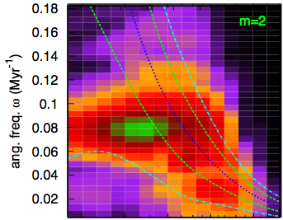
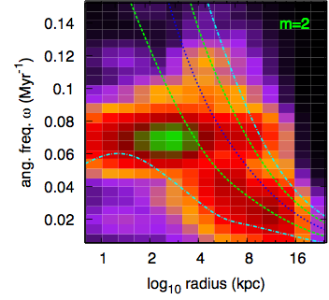
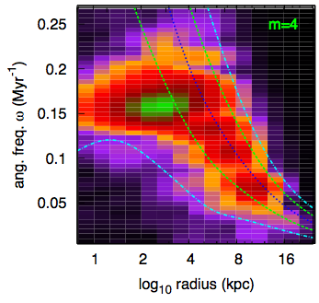
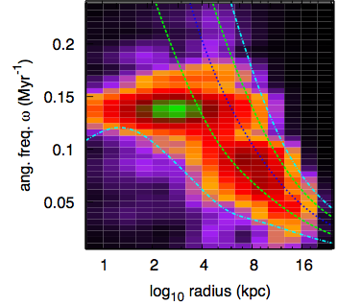
Spectrograms: mid and late simulation
early
m=2
power as a function of frequency
m=2
late
angular frequency
early
m=4
late
m=4
Bar is slowing down. Similarity of spectrograms at different times during simulation implies that waves are coupled.
log₁₀ radius(kpc)

Slide 18
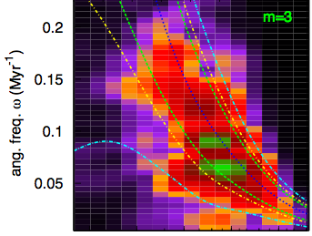
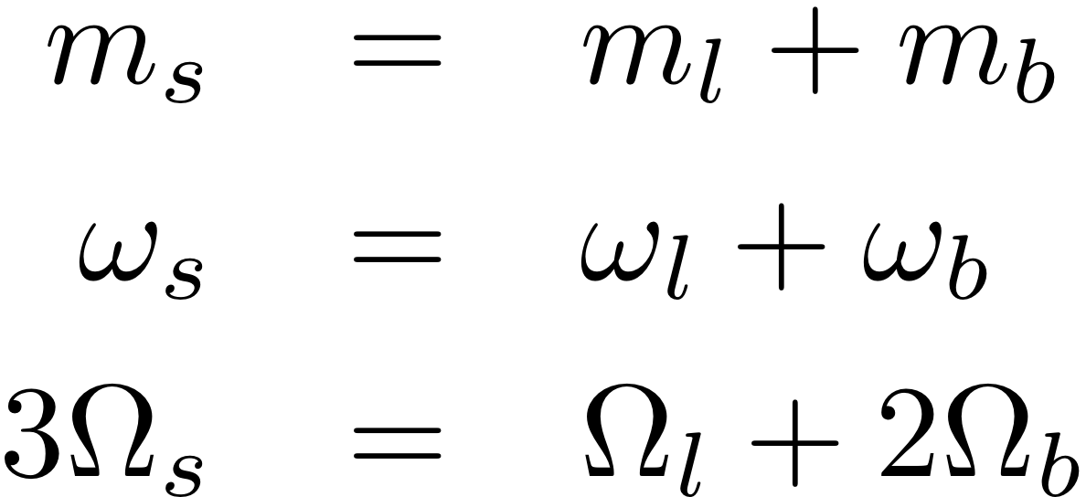
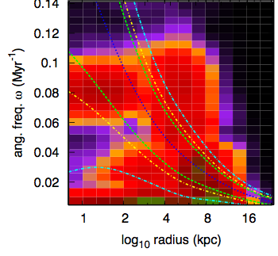
Three-armed wave
Non-linear Wave coupling
Bar and slow lopsided structure, likely coupled to three-armed waves
Sygnet et al. 88
Tagger et al. 97
Masset & Tagget 87
Rautiainen et al. 99
spiral = lopsided + bar
m=1
log₁₀ radius(kpc)

Slide 19
Local neighborhoods
velocity distributions
v→
u→
cartesian coordinates
polar coordinates

Slide 20
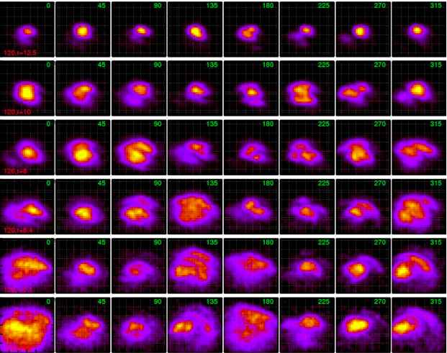
Local velocity distributions
u
r₀=12.5
v
r₀=10
r₀=8
radius
r₀=6.4
r₀=5.1
r₀=4.1
angle w.r.t. bar

Slide 21
As a function of time
Notes:
movie: page.mov

Slide 22
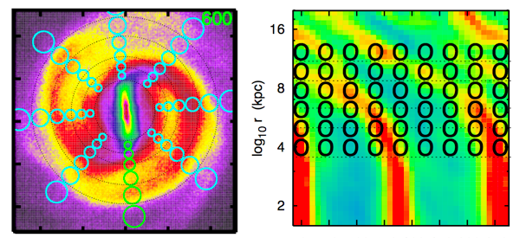
Comments on the local velocity distributions
Low dispersion inter-arm
Higher dispersions and arcs on arm peaks
Gaps, arcs and clumps everywhere in the galaxy
Gaps from bordering neighborhoods tend to be at shifted v velocities.
v sets angular momentum so mean orbital radius

Slide 23
Discontinuities in spiral structure
relation between orientation vectors and velocity distribution

Slide 24
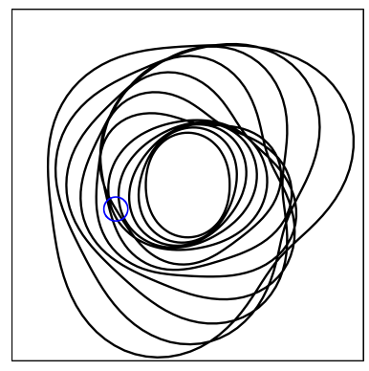
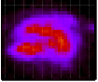
Discontinuities in spiral structure when multiple waves are present
Armlets
Kinks or bends in spiral arms
Manifest in velocity distributions as gaps
2 armed inner + 3 armed outer pattern

Slide 25
Gaps in the velocity distribution
We thought we would see gaps associated with resonances
We instead we saw gaps associated with discontinuities in spiral arms, present because there were more than one wave?
Are resonances related to transitions between patterns?

Slide 26
at solar neighborhood like location with correct angle w.r.t. bar
picking times with velocity distributions like the solar neighborhood’s
Hipparcos velocity distribution
Bob Hurt’s cartoon

Slide 27
Local velocity distribution does not strongly constrain structure on the other side of the Galaxy
≠
3 armed structures should be considered for the Milky Way, near the Solar neighborhood

Slide 28
Interference between waves
Spiral arms appear and disappear
Bursts of star formation can appear and move across the galaxy
Star formation as a tracer for variations in spiral structure
See talk by Claire Dobbs on patterns of star formation

Slide 29
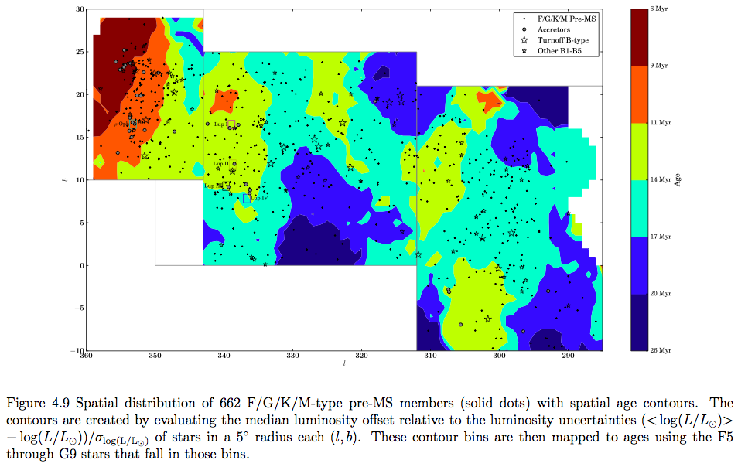
Pattern of Star formation in the Sco-Cen OB association
age
30
young
6Myr
Mark Pecaut PhD thesis 2013
9Myr
Upper Scorpius
145 pc
Upper Centaurus
Lupus 142 pc
11Myr
galactic latitude (b)
14Myr
Lower Centaurus Crux 118 pc
17Myr
50pc
Moving groups!
20Myr
-10
older
26Myr
360
galactic longitude (l)
290

Slide 30
330
300
Armlet or spur?
Sco Cen

Slide 31
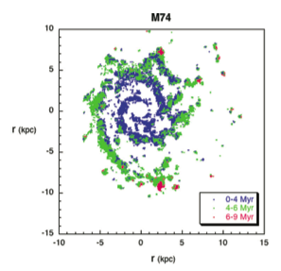
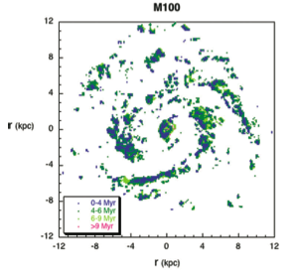
Patterns of Star Formation
Sanchez-Gil et al.(2011)
1 kpc/Myr corresponds to 1000 km/s and is unphysical
Velocity gradient between old and new stars should be r(Ω-Ω_{p}) and so should lie below circular velocity 200km/s = 0.2kpc/Myr

Slide 32
Patterns of Star Formation
Sanchez-Gil et al.(2011)
Resolved gradients can be due to growth/disappearance of spiral features or multiple pattern interference, or external perturbations, not single patterns

Slide 33
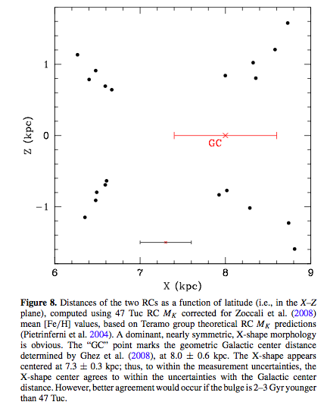
The Milky Way’s X-shaped bulge
McWilliam & Zoccalli (2010)
Red clump giants recently discovered to form an X-shape in the bulge of the Milky Way (also see Nataf et al. 2010, Saito et al. 2011, Li & Shen 2012)
ngc 7582
Milky Way may host a peanut shaped bulge
(talk by Juntai Shen)

Slide 34
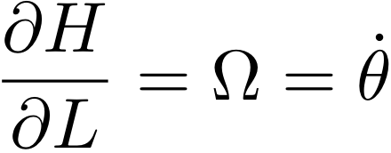
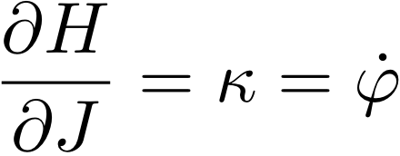
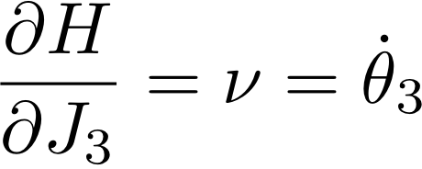
Hamiltonian Model for an axi-symmetric system
vertical frequency
angular rotation rate
epicyclic frequency
rotation
Hamilton’s equations
epicyclic motion
vertical motion
Hamiltonian is independent of angles → L,J, J₃ conserved
With a better approximation H₀ depends on J², J₃²

Slide 35
Vertical resonances
commensurability between vertical oscillations and rotation in frame of bar
BANANA orbits
Integrate this
resonant angle.
Fixed for periodic orbits

Slide 36
Hamiltonian model for banana orbits
from unperturbed Hamiltonian
bar perturbation
distance to resonance
a frequency that
depends on radius
resonant angle
bar strength
Fourier components with fast angles can be neglected via averaging
Hamiltonian then only contains one angle, so can perform a canonical transformation and reduce to a one dimensional system

Slide 37
Vertical resonances with a bar
Orbits in the plane
Increasing radius
Banana shaped periodic orbits
Orbits in the plane

Slide 38
Analogy with the capture of Pluto by Neptune
plutinos
Kuiper belt
As Neptune moves outwards, Pluto’s eccentricity increases
As the bar grows and slows down and the galaxy thickens, captured stars increase in height
eccentricity
Wm. Robert Johnston
semi-major axis

Slide 39
As the bar grows, stars are lifted Resonance trapping
Growing bar
Slowing bar
Extent stars are lifted depends on the initial radius
An explanation for sharp edge to the peanut in boxy-peanut bulges.
Maybe give precise constraints on bar growth and bulge structure

Slide 40
Phase wrapping
→
V_{R}
R →
Two settings:
Minor merger debris originates in a particular region in phase space
Background galaxy is perturbed resulting in an uneven distribution in phase space

Slide 41
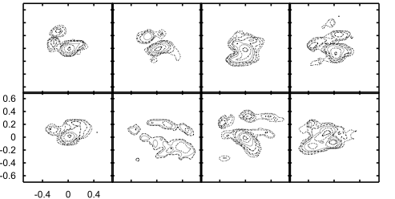
Disk perturbed by a low mass satellite passing through the outer Galactic disk
v
u
streams induced over short timescales as well as heating and mixing
(Quillen et al. 2009)

Slide 42
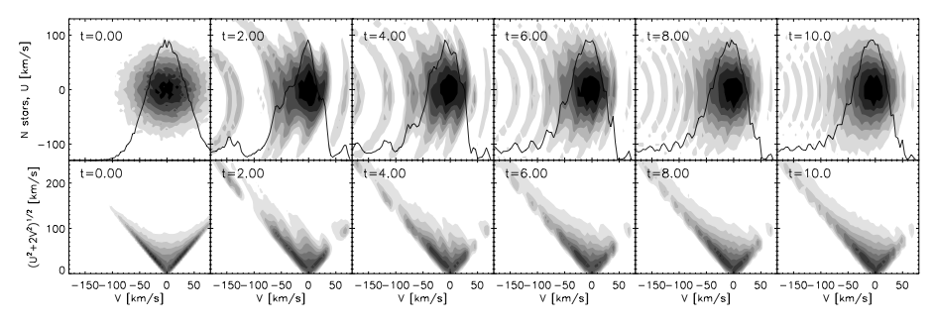
Phase wrapping in the disk
following uneven distribution in epicylic oscillation angle, the thick disk can exhibit streams (Minchev et al. 2009)
u
v
time
Semi-analytical model constructed by weighting with epicyclic angle

Slide 43
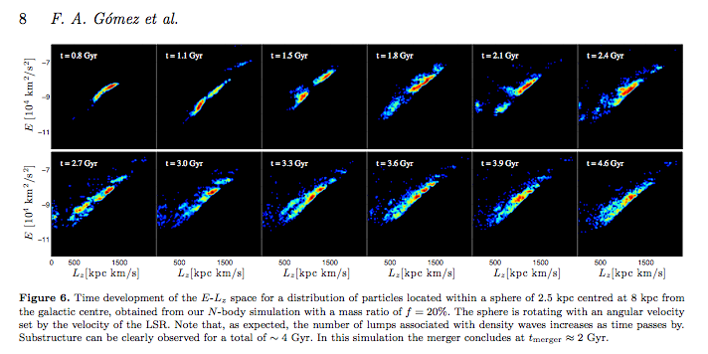
Signature of a minor merger in the distribution of disk stars in an N-body simulation
Substructure in E/L persists for 2 Gyr after merger
Gomez et al. (2011)

Slide 44
Summary/Conclusion
Beautiful rich dynamics implies that we will continue to discover structure in forthcoming large scale surveys of the Galaxy disk
Prospects of precision measurements as well as constraints on past evolution

Slide 45
Dissolution of a cluster
Notes:
clustermovie.gif

