Slide 1
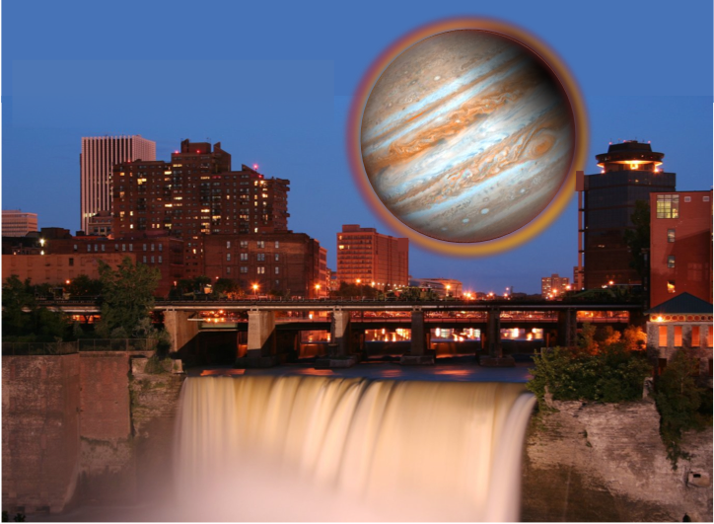
Origin Scenarios for Multiple Planet Systems
Alice Quillen
University of Rochester

Slide 2
Conjunctions between Kep 36 planets
Conjunction every 97 days (7 times orbital period of inner planet or 6 times orbit of outer planet)
Distance between planets at conjunction is 85 planet radii or 2 million km (about 5 times the distance between the Earth and Moon).
A viewer on planet b would see an angular diameter for planet c of 1.3 degrees. About 3 times larger than the Sun or Moon on the sky. Large size lasting a few days!
Angular Velocity on the sky (~1.5 degree/hour) with respect to the back ground stars is about 3 times faster than Moon as seen from the Earth

Slide 3
In collaboration with
Alex Moore
Imran Hasan
Eva Bodman
Richard Edgar

Slide 4
Kepler Observatory Search for Planetary Transits in Light-curves
(Carter et al. 2012)
Kepler 36b
Kepler 36c

Slide 5
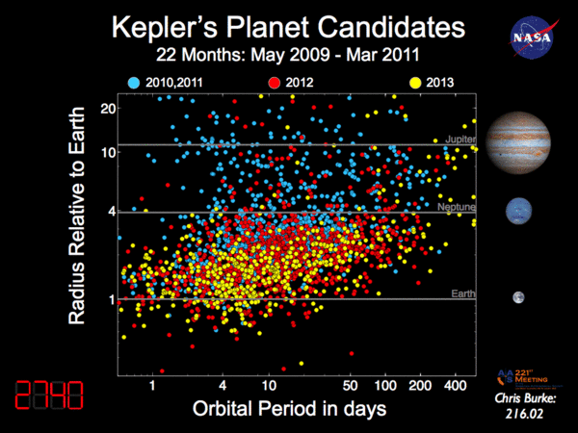

Slide 6
Multiple planet systems

Slide 7
The Kepler Multiple planet systems
Lower planet masses than Doppler (radial velocity discovered) planets
closely packed, short periods, compact systems
nearly circular orbits
low inclinations
Statistically significant number of planet pairs near or in resonance
Kepler planet candidate pairs
(Fabrycky et al. astroph 2012)
number of pairs
period ratio

Slide 8
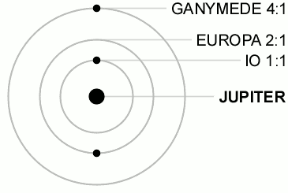
Orbital resonance
The ratio of orbital periods of two bodies are nearly equal to a ratio of small integers
using mean motions (angular rotation rates)
integrating to give a resonant angle

Slide 9
Three unique and very different multiple planet systems
Kepler 36
two transiting super-Earth planets in nearby orbits, near the 7:6 resonance and with extreme density contrast around a solar mass subgiant
HR 8799 (discovered via optical imaging)
4 massive super-Jovian planets, with a debris disk in a young system around an A star, 3 planets in a chain of mean motion resonances 4:2:1
KOI 730 (Kepler candidate system)
4 transiting super-Earth planets in a chain of mean motion resonances around a Solar type star, 8:6:4:3 commensurability

Slide 10
What do the resonant systems tell us about planetary system formation and evolution?
Resonant systems can be delicate → constraints on asteroid/planetesimal belts that can nudge planets out of resonance
Resonances are narrow. Migration of planets allows capture into resonance → constraints on migration processes
e.g., work by Man-Hoi Lee 2002, Willey Kley 2004, and Hanno Rein 2012

Slide 11
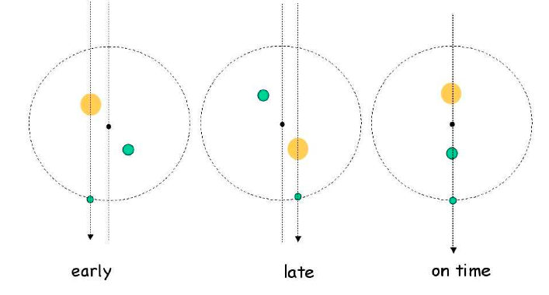
Transit Timing Variations
star + two planets
Figure: Agol et al. 2004
Shift in location of center of mass of internal system causes a change in the time of the transit of outer planet
Length of a transit gives a measurement for the radius of a planet, not its mass.
Transit timing variations allow measurement of planet masses!
Compact or/and resonant transiting systems give measurable transit timing variations. Planetary sized masses can be confirmed.
Both planetary masses and radii are measured in the Kepler 36 system

Slide 12
Transit timing variations in the Kepler 36 system
Kep 36b transits
Kep 36c transits
Fits to the transit timing make it possible to measure the masses of both planets
TRANSIT NUMBER
Carter et al. 2012

Slide 13
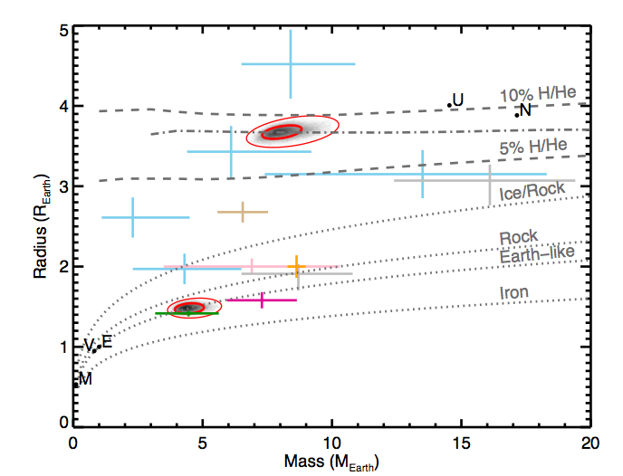
Mass Radius relation of Kepler planets
Kepler 36c outer planet fluffball
Other exoplanets
blue, Kepler-11
pink, Kepler-18b
gray, Kepler-20 b and c
brown, GJ 1214b violet, CoRoT-7b
green, Kepler-10b
orange, 55 Cnc e
Kepler planets have a wide distribution of densities and so compositions!
Kepler 36b inner planet
solid rock+iron!
Carter et al. 2012

Slide 14
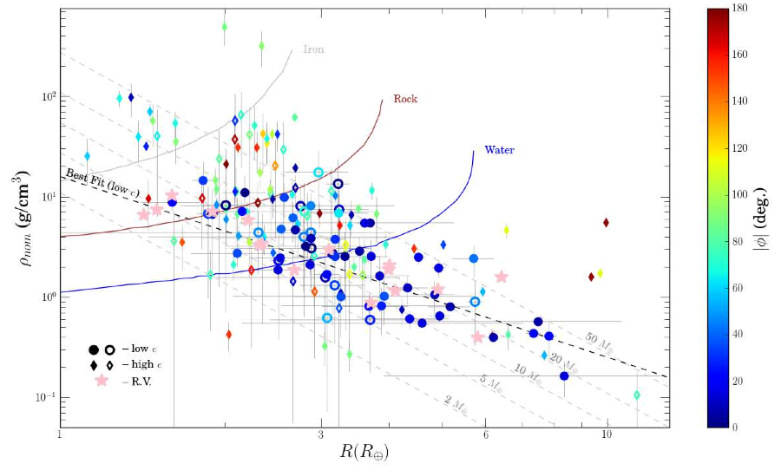
Larger sample TTV planet pairs
Iron
Hadden & Lithwick 2013
density
Rock
Water
ttv phase
radius

Slide 15
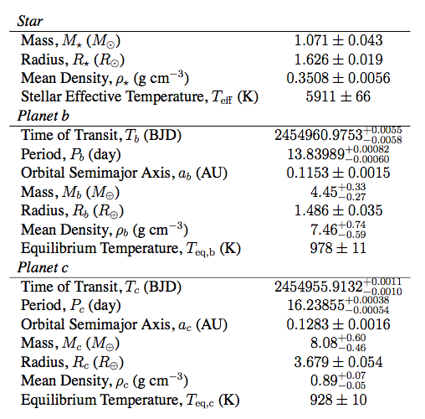
Kepler 36 system
Carter et al. (2012)
measured via
astro-seismology
inner planet
Two planets, near the 7:6 resonance
Large density contrast
outer planet

Slide 16
Quantities in the Kepler 36 system
 | Planet b | Planet c
Planet mass/Stellar mass | 1.15x10⁻⁵ | 2.09x10⁻⁵
Orbital velocity/Escape velocity | 4.8 | 5.3
Semi-major axis /Hill radius | 63.9 | 52.3
Hill radius/Planet radius | 29.0 | 16.0
Semi-major axis/Planet radius | 1852 | 838
Ratio of orbital periods is 1.1733 (7/6=1.1667)
Distance between planets at conjunction is only
4.8 Hill radii! (Chaotic dynamics: Deck et al. 2012)
Planet sizes are large compared to volume: Integrations must check for collisions
Circular velocity is ~90 km/s

Slide 17
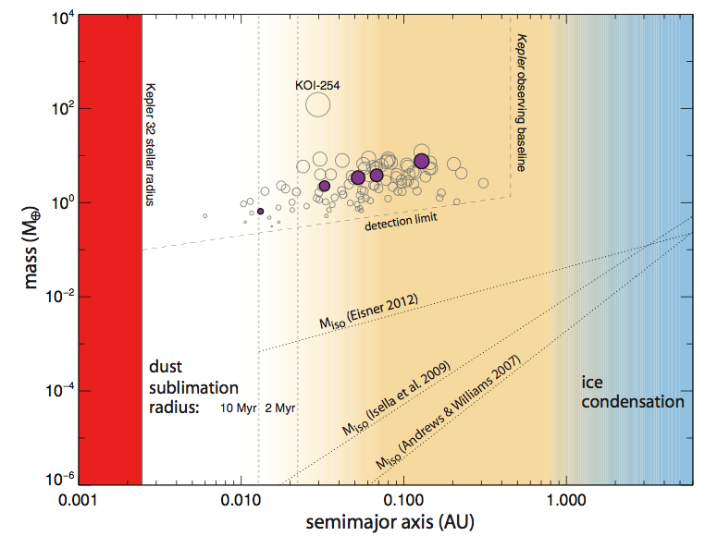
Problems with in-situ formation
Petrovich et al. 2013: can only approximately match period distribution near 3:2 resonance
Hanson & Murray 2013: cannot account for fraction of 1 planet systems
Swift et al. 2013 on Kepler 32 system: Extremely massive primordial disk required in M star compact multiple planet systems, planets exist at boundary of dust sublimation radius

Slide 18
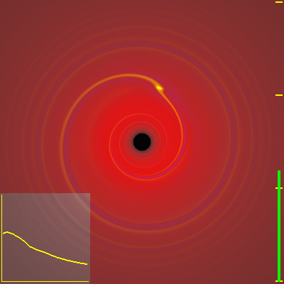
Planetary Migration Scenarios
A planet embedded in a gas disk drives spiral density waves
Damps the planet’s eccentricity
The planet usually moves inwards
facilitates convergent migration and resonance capture
planet
Phil Armitage

Slide 19
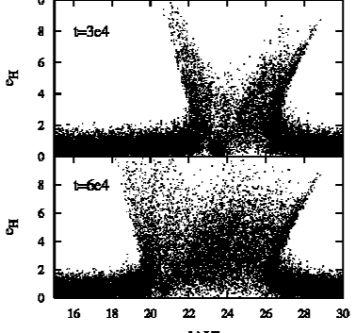
Migration via Scattering Planetesimals
A planet can migrate as it ejects and scatters planetesimals
Facilitates divergent migration
Pulling planets out of resonance or resonance crossing
Kirsh et al. 2009
eccentricity/eH
semi-major axis in AU

Slide 20
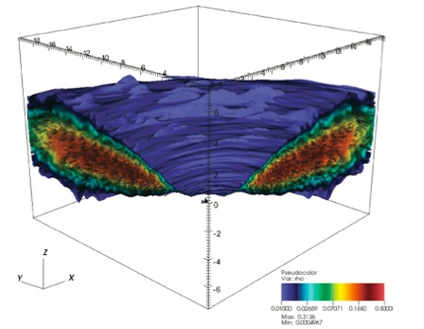
Stochastic migration
Planet receives little random kicks
Due to density variations from turbulence in the gas disk (e.g., Ketchum et al. 2011)
Due to scattering with planetesimals (e.g., previously explored for Neptune by R. Murray-Clay and J. Hahn)
Jake Simon

Slide 21
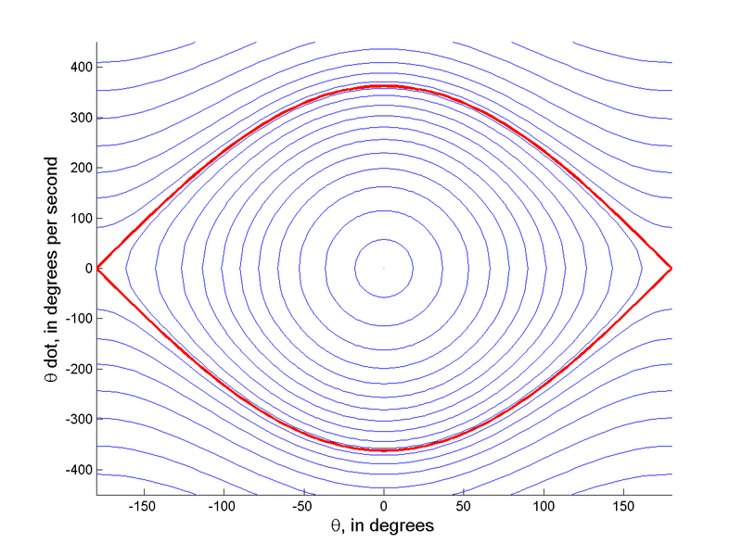
Mean motion Resonances
Can be modeled with a pendulum-like Hamiltonian
θ Resonant angle. Two types of motion, librating/oscillating in or out of resonance
Level curves showing orbits
expand Kepler Hamiltonian
due to two-planet interactions
This model gives:
resonant width, strength, libration frequency, adiabatic limit, eccentricity variation in resonance, probability of capture

Slide 22
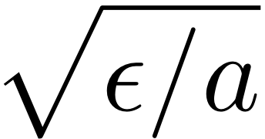
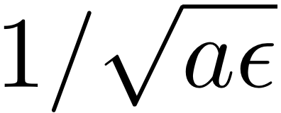
Dimensional Analysis on the Pendulum
H units cm² s⁻²
Action variable p cm² s⁻¹
(H=Iω) and ω with 1/s
a cm⁻²
b s⁻¹
Drift rate db/dt s⁻²
ε cm² s⁻²
Ignoring the distance from resonance we only have two parameters, a,ε
Only one way to combine to get momentum
Only one way to combine to get time
Distance to resonance

Slide 23
Sizescales on the Pendulum
Libration timescale ~
Momentum variation in resonance
Distance to resonance
Adiabatic limit
Critical eccentricity set from momentum scale
Perturbation required to push system out of resonance set by momentum scale
Drift rate allowing capture set by adiabatic limit

Slide 24
Dimensional analysis on the Andoyer Hamiltonian
We only have two important parameters if we ignore distance to resonance
a dimension cm⁻²
ε dimension cm^{2-k} s^{-2-k/2}
Only one way to form a timescale and one way to make a momentum sizescale.
The square of the timescale will tell us if we are in the adiabatic limit
The momentum sizescale will tell us if we are near the resonance (and set critical eccentricity ensuring capture in adiabatic limit)

Slide 25
First order Mean motion resonances
Two regimes:
High eccentricity:
We model the system as if it were a pendulum with
Low eccentricity :
Use dimensional analysis for Andoyer Hamiltonian in the low eccentricity limit
dividing line dependent on dimensional eccentricity estimate
Before resonance capture we work with the low eccentricity dimensions
After resonance capture we work with the pendulum models.

Slide 26
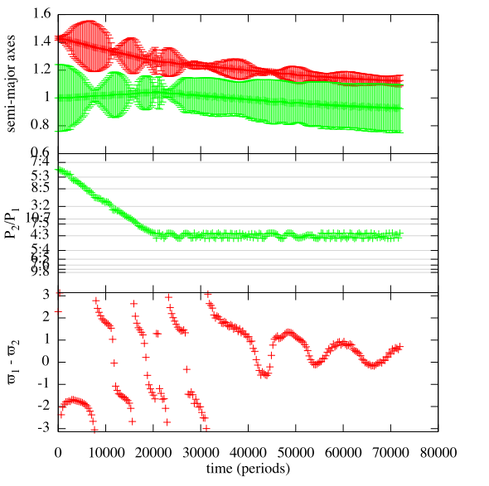
Can the Kepler 36 system be formed with convergent migration?
Two planet + central star N-body integrations
Outer planet migrates
damping is forced by adding a drag term in the integration
Eccentricity damping
forced circularization using a drag term that depends on the difference in velocity from a circular orbit
semi-major axes with peri and apoapses
period ratio semi-major axes
4:3 resonance
apsidal angle
apsidal angle = 0 in resonance
(see Zhou & Sun 2003, Beauge & Michtchenko, many papers)
time →

Slide 27
Drift rates and Resonant strengths
If migration is too fast, resonance capture does not occur
Closer resonances are stronger. Only adiabatic (slow) drifts allow resonance capture.
Can we adjust the drift rate so that 4:3, 5:4, 6:5 resonances are bypassed but capture into the 7:6 is allowed?
Yes: but it is a fine tuning problem. The difference between critical drift rates is only about 20%

Slide 28
Eccentricities and Capture
High eccentricity systems are less likely to capture
Can we adjust the eccentricities so that resonance capture in 4:3, 5:4, 6:5 resonances is unlikely but 7:6 possible?
No. Critical eccentricities differ by only a few percent.
secular oscillations
eccentricity jump due to 7:5 resonance crossing
period ratio semi-major axes
capture into 3:2 prevented by eccentricities
resonances are bypassed because of eccentricities
time →
Secular oscillations and resonance crossings make it impossible to adjust eccentricities well enough

Slide 29
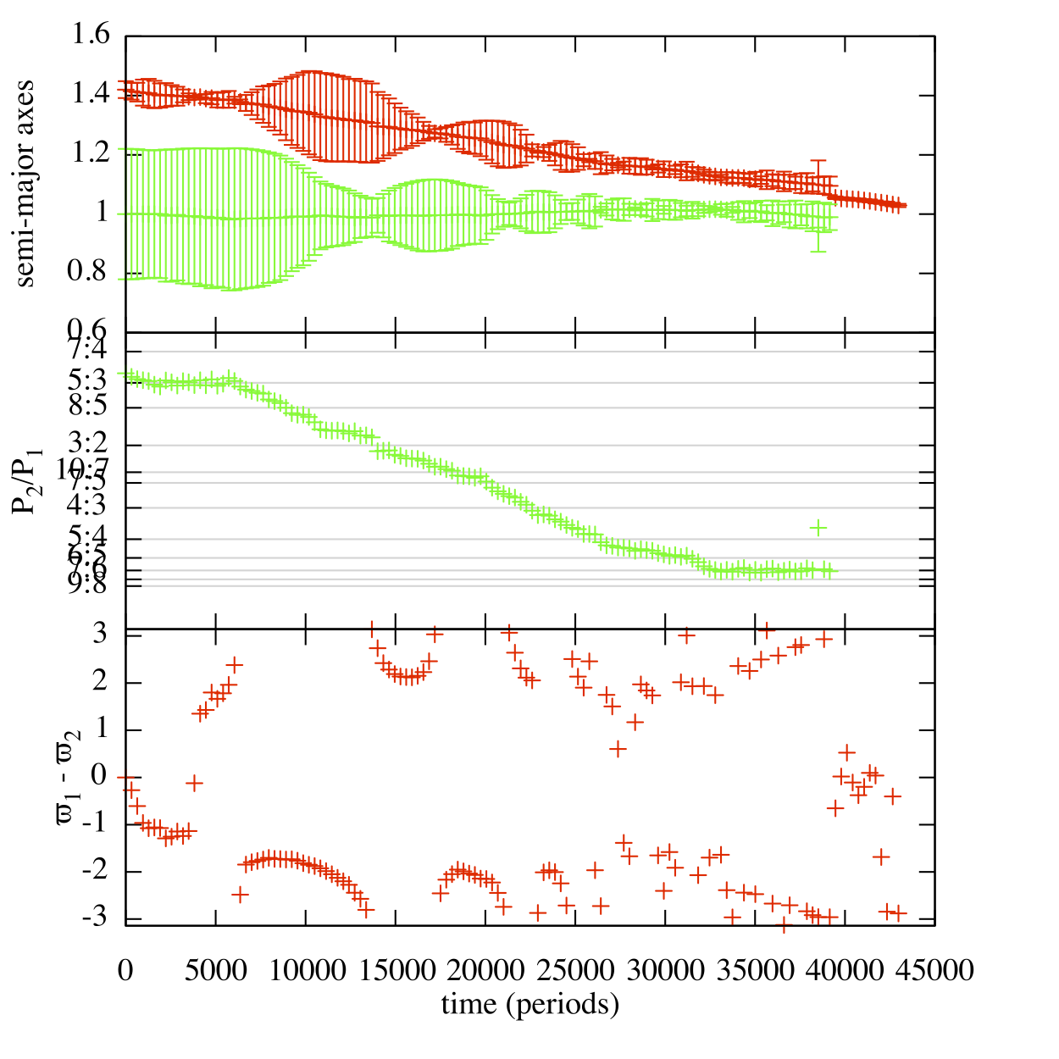
Stochastic migration
Rein(2013) accounts for distribution of period ratios of planet pairs using a stochastic migration model
Does stochastic migration allow 4:3, 5:4, and 6:5 resonances to be bypassed, allowing capture into 7:6 resonance?
Yes, sometimes (also see work by Pardekooper and Rein 2013)
Random variations in semi-major axes can sometimes prevent resonance capture in 4:3, 5:4, 6:5 resonances
period ratio semi-major axes
capture into 7:6!
resonances
bypassed
time →

Slide 30
Problems with Stochastic migration
planets collide!
Stochastic perturbations continue after resonance capture
System escapes resonance causing a collision between the planets
period ratio semi-major axes
time →

Slide 31
Problems with Stochastic migration
If a gas disk causes both migration and stochastic forcing, then planets will not remain in resonance
Timescale for escape can be estimated using a diffusive argument at equilibrium eccentricity after resonance capture
Timescale for migration is similar to timescale for resonance escape
→ Disk must be depleted soon after resonance capture to account for a system in the 7:6 resonance --- yet another fine tuning problem
Density difference in planets not explained

Slide 32
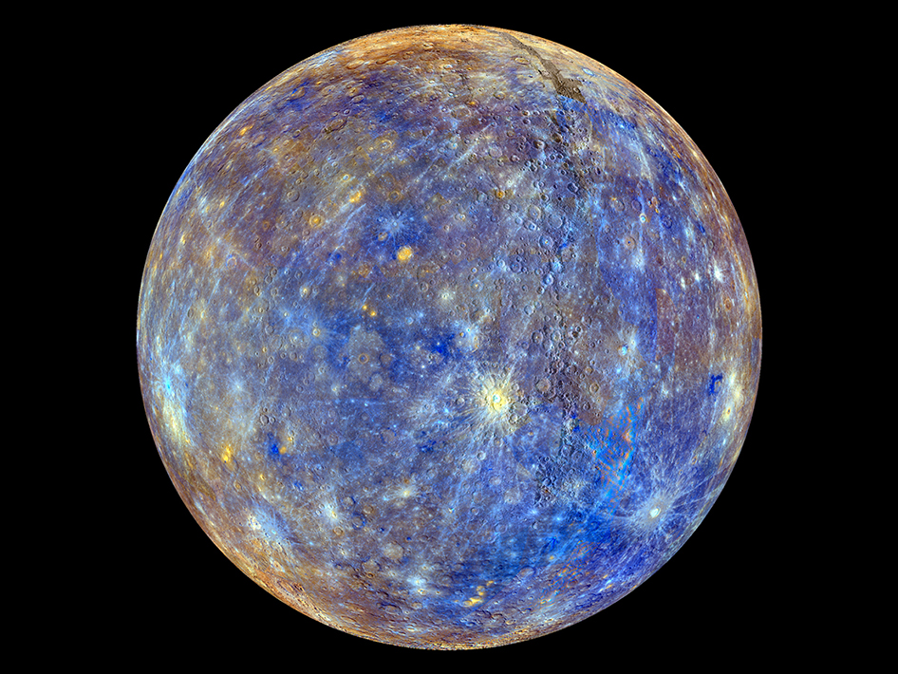
Collisions are inevitable
Kepler Planets are close to their star
Consider Planet Mercury, closest planet to the Sun
Mercury has a high mean density of 5.43 g cm⁻³ Why?
Fractionation at formation (heavy condensates)
afterwards slowly, (evaporation)
afterward quickly (collision)
See review by Benz 2007
MESSENGER image

Slide 33
Giant Impact Origin of Mercury
Grazing collision stripped the mantle, leaving behind a dense core that is now the planet Mercury (Benz et al. 2008)

Slide 34
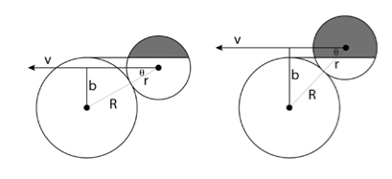
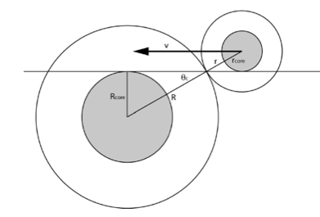
Geometry of collisions
Figures by Asphaug (2010)
direct collision
grazing collision
hit and run,
mantle stripping

Slide 35
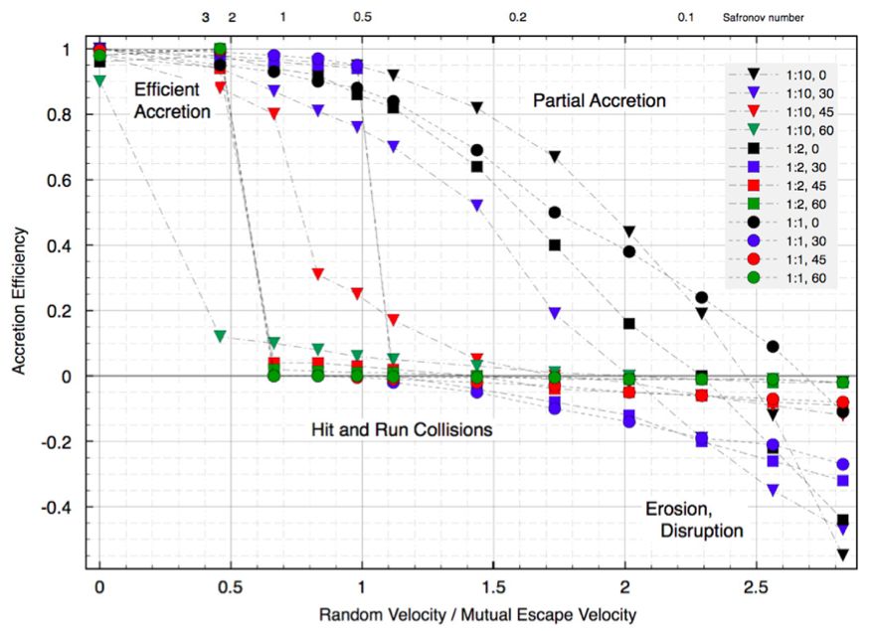
impact angle
envelope stripping
Asphaug(2010)
slow collisions
fast collisions

Slide 36
Alternate scenarios/mechanisms for density variations
Photoevaporation and atmospheric escape Owen & Wu 2013, Lopez & Fortney 2013
Critically dependent on core mass.
However: densities of Kepler planets are NOT strongly dependent on semi-major axis (Hadden & Lithwick 2013)
→ there are other processes affecting planetary density

Slide 37
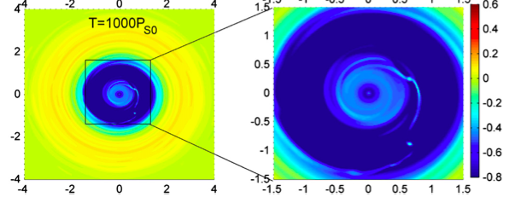
Planetary embryos in a disk edge
Zhang & Zhou 2010
Embryos can lie in the disk here!
``Planet trap’’ + transition disk setting (e.g., Terquem & Papaloizou 2007, Moeckel & Armitage 2012, Morbidelli et al. 2008, Liu et al. 2011)
We run integrations with two planets + 7 embryos (twice the mass of Mars)
no applied stochastic forcing onto planets, instead embryos cause perturbations
The outermost planet and embryos external to the disk edge are allowed to migrate

Slide 38
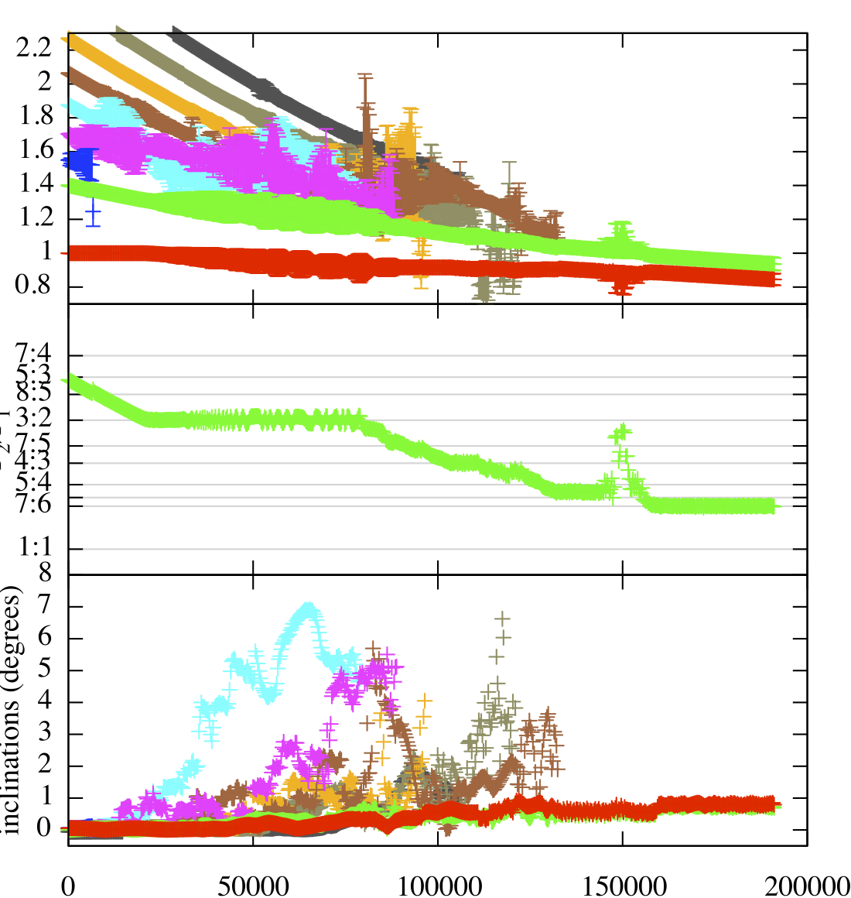
Integrations of two planets and Mars mass embryos
embryos migrate inwards
Collisions with inner planet. Potentially stripping the planet in place
semi-major axes
two planets
encounter with embryos nudge system out of 3:2 resonance
period ratio
Integration ends with two planets in the 7:6 resonance and in a stable configuration
inclinations
time

Slide 39
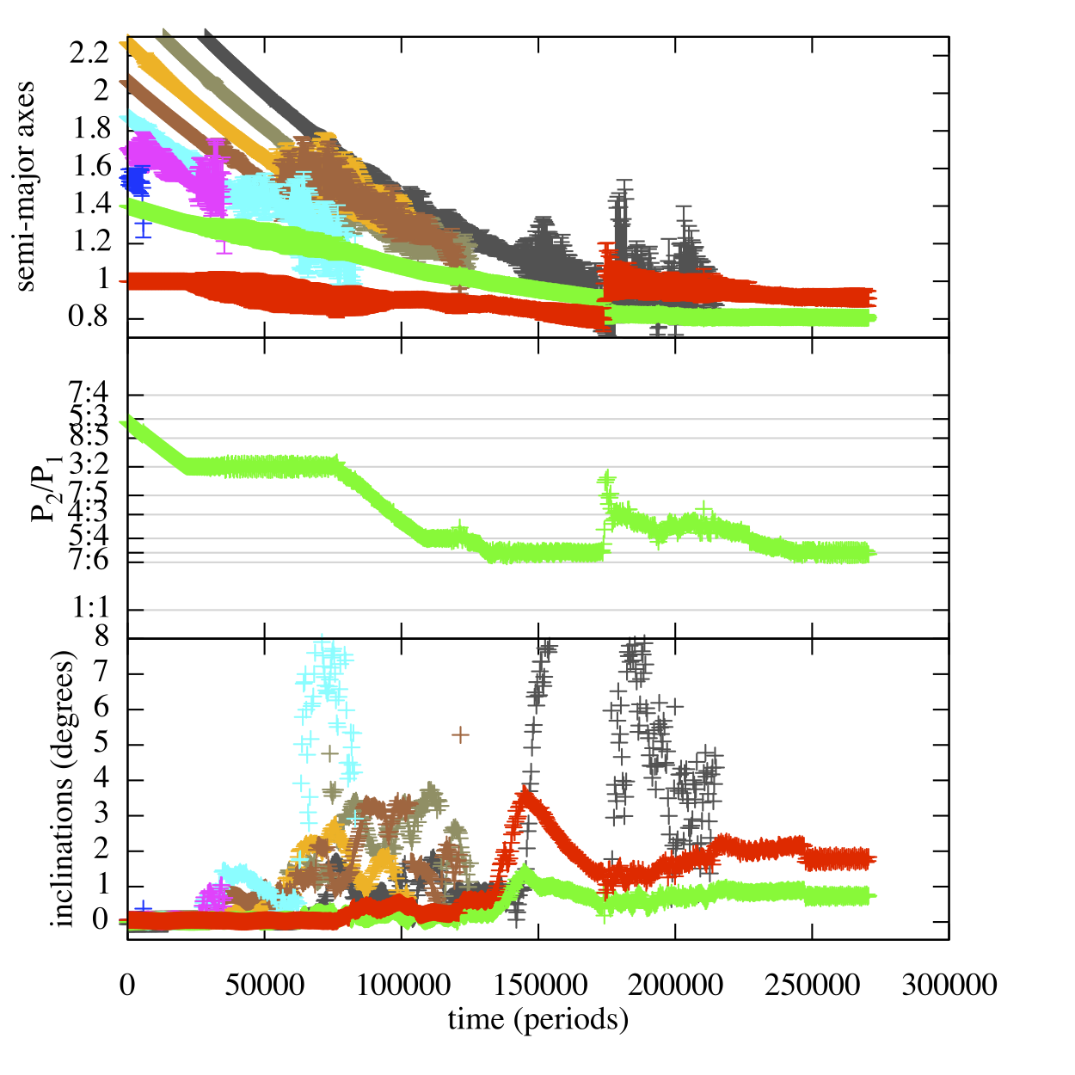
another integration
Inner and outer planet swap locations
Outer planet that had experienced more collisions becomes innermost planet
semi-major axes
encounters with embryos nudge system out of 3:2, 5:4 resonances
period ratio
Integration ends with two planets in the 6:5 resonance and in a stable configuration
inclinations
time

Slide 40
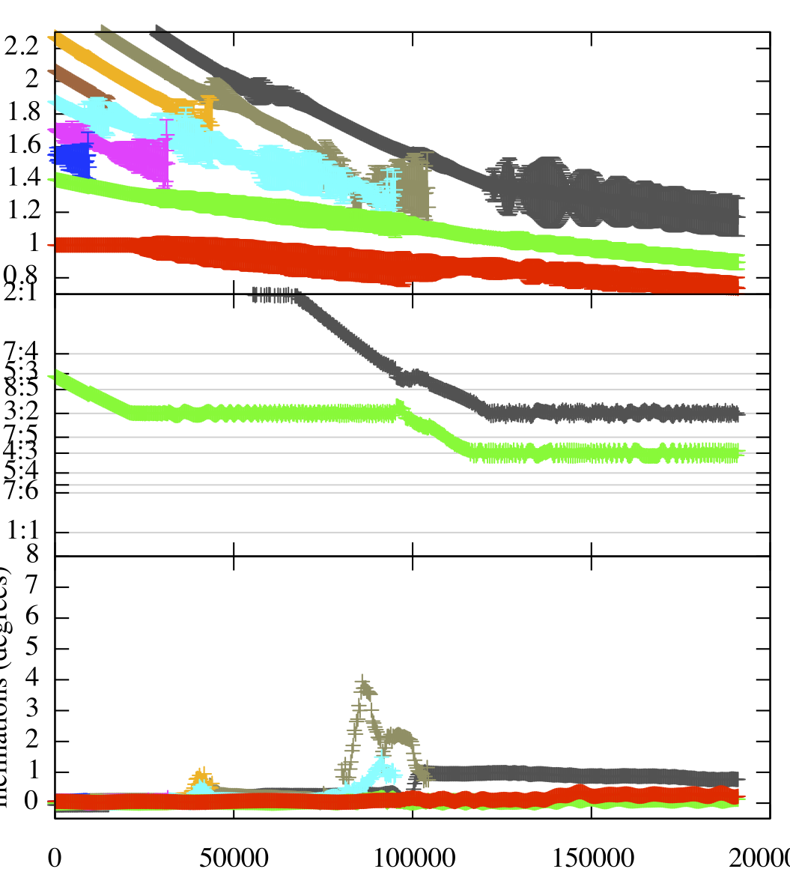
another integration
semi-major axes
Final state can be a resonant chain like KOI 730
period ratio
Integration ends with two planets in the 4:3 resonance and an embryo in a 3:2 with the outer planet
If a misaligned planet existed in the Kepler 36 system it would not have been seen in transit
inclinations
time

Slide 41
Diversity of Simulation Outcomes
Pairs of planets in high j resonances such as 6:5 and 7:6. Appear stable at end of simulation
Pairs of planets in lower j resonances such as 4:3
Resonant chains
Collisions between planets and between planets and embryos
Embryo passed interior to two planets and left there (possibly inside sublimation radius, as for innermost planet in Kep 32 system)
Comments
Collisions affect planetary inclinations -- transiting objects are sensitive to this
A different kind of fine tuning: Numbers and masses of embryos. Outcome sensitive to collisions!

Slide 42
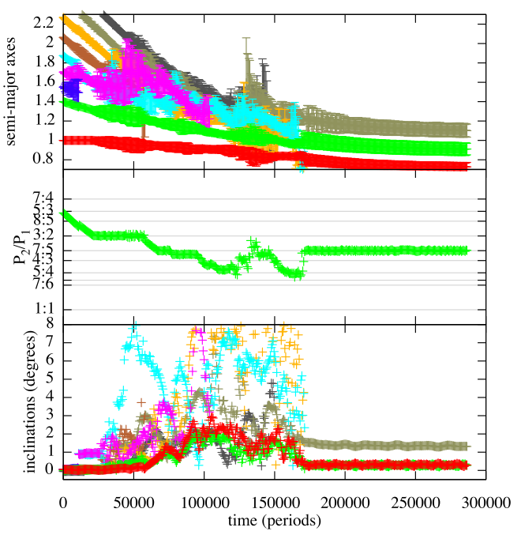
7:5
Some simulations gave two planets in 7:5 resonance.
7:5 is just inside the 3:2 resonance.
In smooth or stochastic migration scenarios, it is extremely unlikely to avoid capture into the stronger first order 3:2 resonance yet allow capture in 7:5

Slide 43
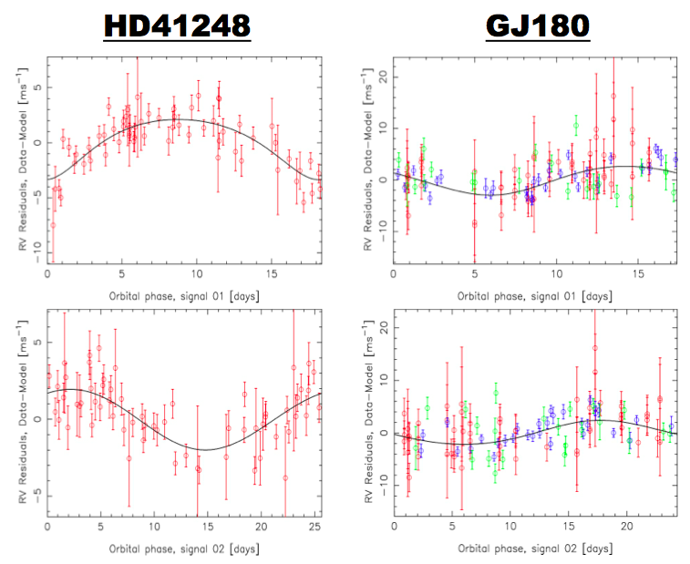
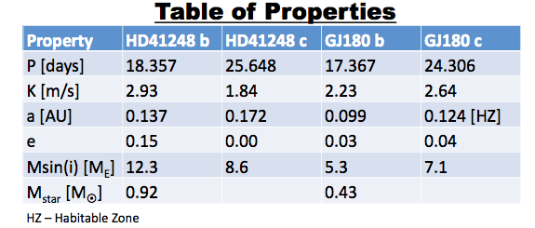
Recent Discovery of two systems in the 7:5 James S. Jenkins, & Mikko Tuomi
Phase folded radial velocity curves for the pair of planets orbiting HD41248 (left) and GJ180 (right), with both inner and outer planets shown at the top and bottom. All data for HD41248 is from HARPS, whereas the red, blue, and green data points for GJ180 are taken from UVES, HARPS, and PFS.

Slide 44
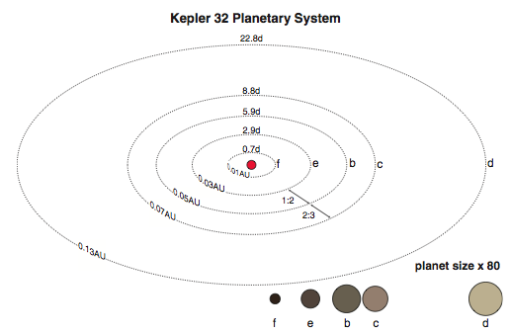
Small inner planet within dust sublimation radius
Kepler 32 system
Swift et al. 2013

Slide 45
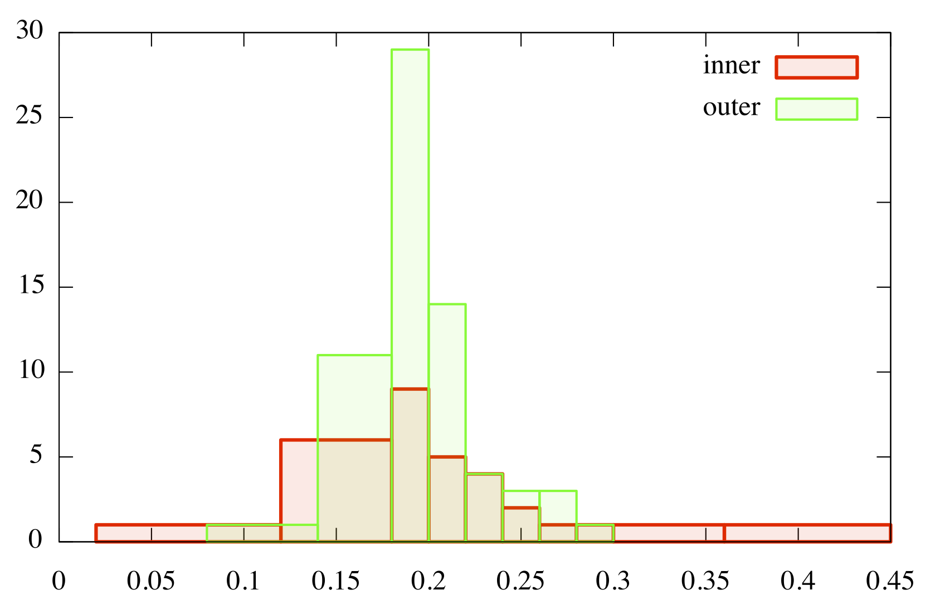
Properties of collisions between embryos and planets
Accretion may still occur
Number of collisions
impacts on inner planet especially likely to cause erosion
v_{impact}/v_{circular}

Slide 46
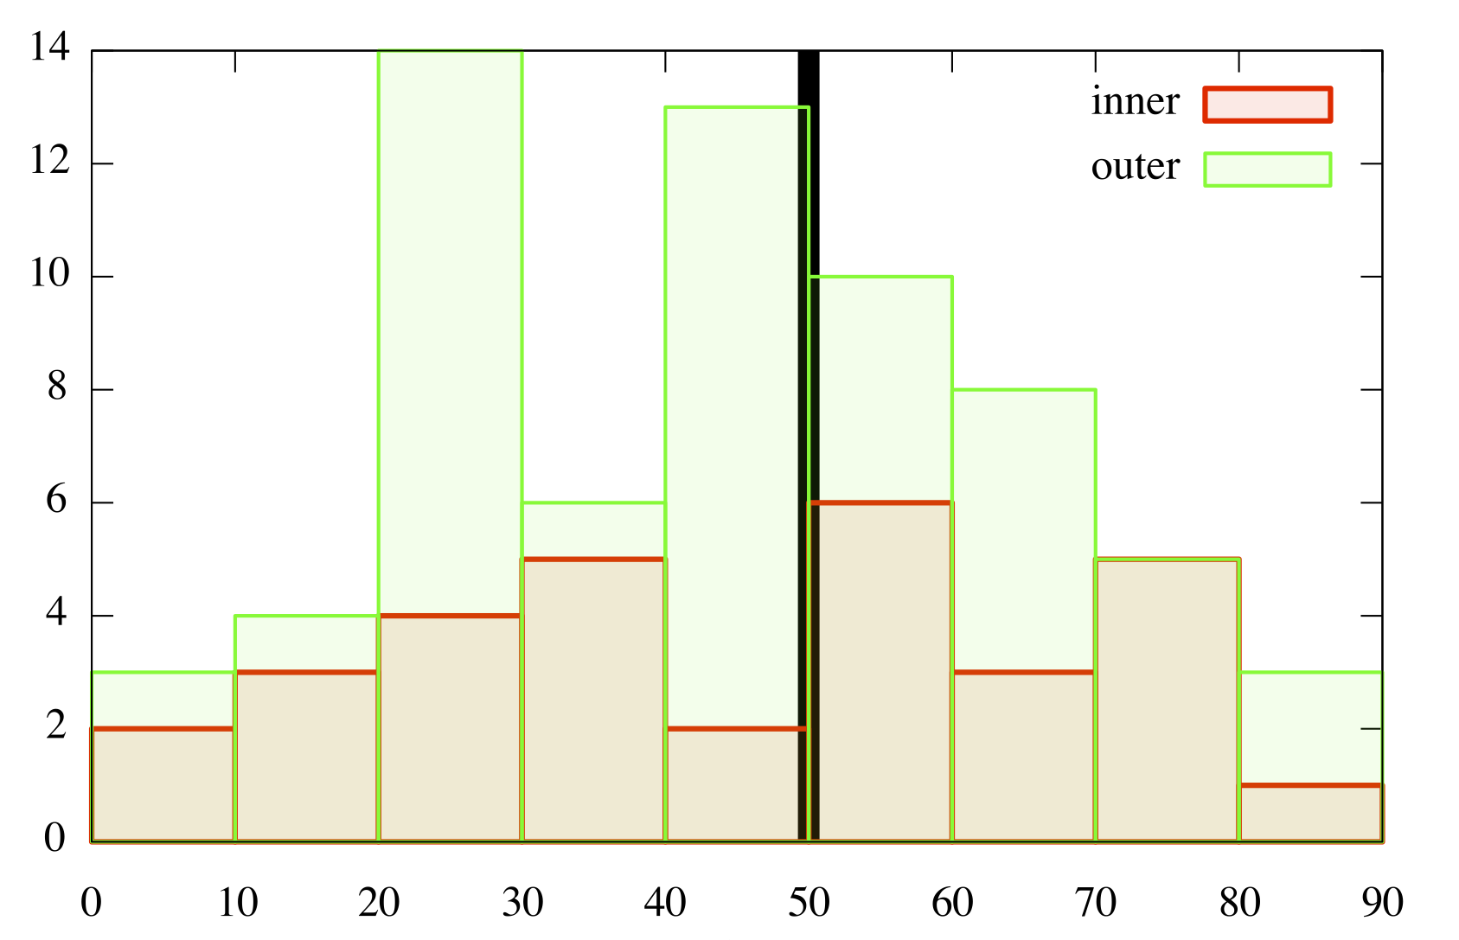
Collision angles
Impacts are normal
Impacts are grazing
High velocity, grazing impacts are present in the simulation suggesting that collisions could strip the envelope of a planet
Number of collisions
Impact angle (degrees)

Slide 47
Kepler 36 and wide range of Kepler planet densities
Both planet migration and collisions are perhaps happening during late stages of planet formation, and just prior to disk depletion …

Slide 48
Resonant Chains
Prior to the discovery of GL876 and HR8799, the only known multiple object system in a chain of mean motion resonances was Io/Europa/Ganymede
Each pair of bodies is in a two body mean motion resonance
Integer ratios between mean motions of each pair of bodies
Convergent migration model via tidal forces for Galilean satellites → resonance

Slide 49
Resonant Chains
Systems in chains of resonances drifted there by convergent migration through interaction with a gaseous disk (e.g. Wang et al. 2012)
Scattering with planetesimals usually causes planet orbits to diverge and so leave resonance
What constraints can resonant chain systems HR8799 and KOI730 give us on their post gaseous disk depletion evolution?

Slide 50
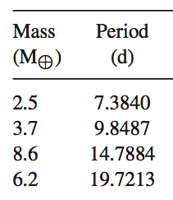
KOI 730 system resonant chain
Discovered in initial tally of multiple planet Kepler candidates (Lissauer et al. 2011)
Planet masses estimated from transit depths
Period ratios obey a commensurability
8:6:4:3
Outer and inner pair in 4:3 resonance
Middle pair in 3:2

Slide 51
KOI-730 system
Suppose after formation the KOI730 system hosts a debris disks of planetesimals. Could planet-orbit-crossing planetesimals (comets) pull the system out of resonance?
How are planetary inclinations affected? To see 4 planets in transit, mutual inclinations must lie within a degree
Find resonant initial conditions
Run N-body integrations (GPU accelerated) with planetesimals that are initially located in a disk exterior to the planets
We ran different simulations with different planetesimal disk masses

Slide 52
Finding Initial Conditions Forced migration Capture into 8:6:4:3
An integration that succeeded in giving the proper period ratios
period ratios
Lots of eccentricity damping required to keep this system stable
Fine tuning in initial conditions and migration rates required
semi-major axes
Capture of one pair often caused another pair to jump out of resonance
time
Initial conditions for our
N-body integration taken here!
not a formation scenario!

Slide 53
KOI 730 Simulations
Simulation | Mass of planetesimal disk | Orbit crossing Mass in Earth Masses
N | Neptune Mass | 16.6
N5 | 1/5 Neptune Mass | 1.7
E | Earth Mass | 0.46
E3 | 1/3 Earth Mass | 0.12
M | Mars Mass | 0.04
Z | No planetesimals | 0
Mass in planetesimals that crossed the planets’ orbits was measured

Slide 54
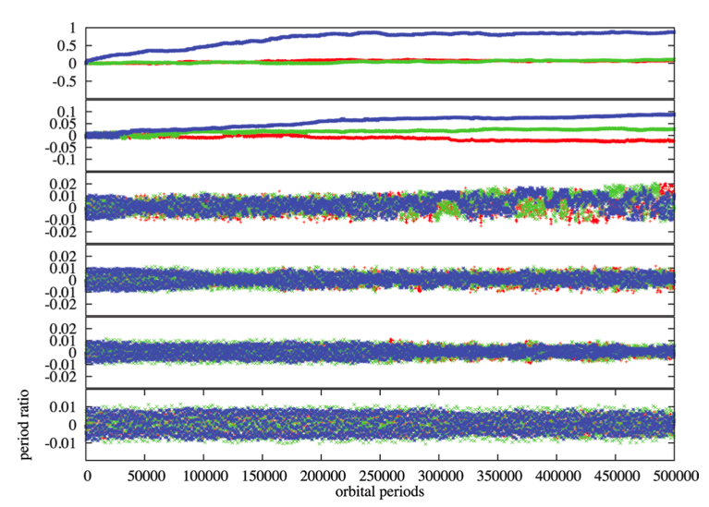
Changes in period ratios
massive planetesimal disk, planets out of resonance
period ratio difference from initial
less planetesimal mass, system still in resonance
time
Moore et al. (2013)

Slide 55
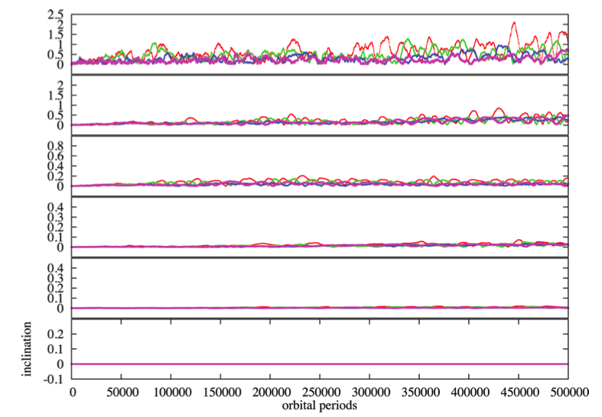
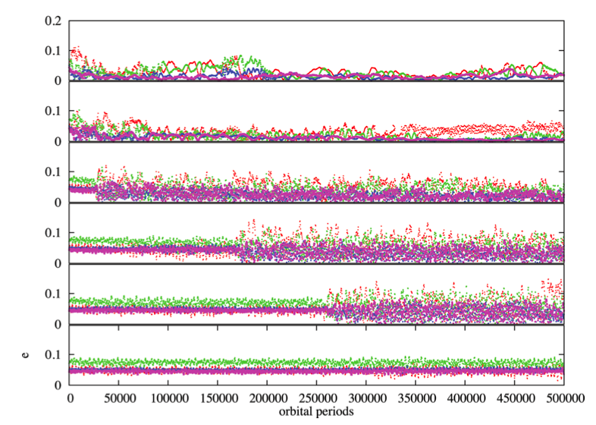
Resonances are crossed, causing of increases in eccentricities and inclinations
massive planetesimal disk
inclinations
eccentricities
less planetesimal mass
inclinations do not damp to zero as would be expected from dynamical friction

Slide 56
Trends seen in the simulations
A Mars mass or orbit crossing planetesimals pulls the system out of resonance.
This can be ruled out for KOI-730! Less than a Mars mass in planetesimals could have crossed the orbits of the KOI-730 planets
An Earth mass of orbit crossing planetesimals, puts system just outside resonance, by an amount similar to the peak seen in a histogram of Kepler system period ratios.
Correlation between orbit crossing mass and inclinations → to look for with Kepler observations

Slide 57
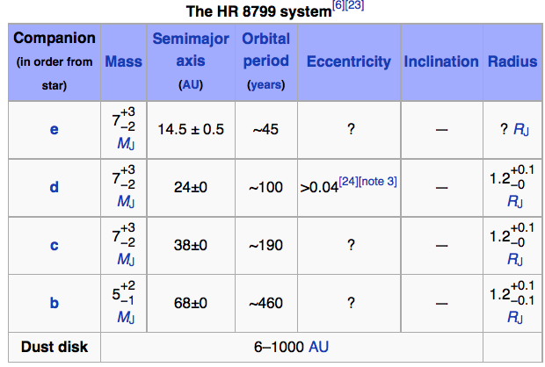
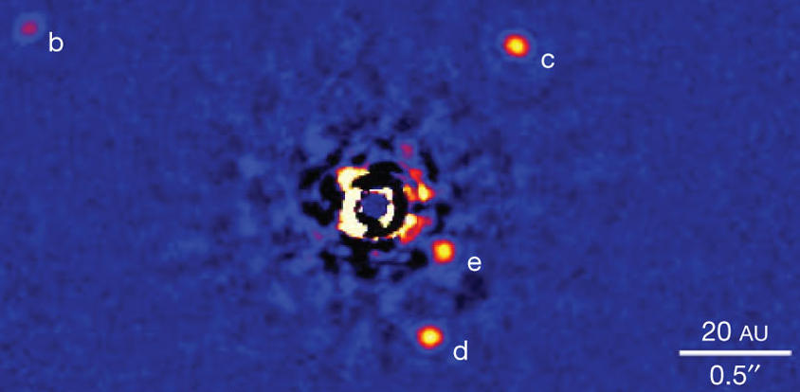
HR8799 system
HR 8799, A star, young!
Hosts a debris disk
4 massive planets
Discovered via optical imaging
Marois et al. 2011
6 — 1000 AU
evidence of debris

Slide 58
HR8799 simulations
Using orbital elements based on observed positions of planets
Different mass planetesimal disks
Start with an unstable planetary configuration. Can the planetesimal disk can stabilize the system via eccentricity damping? No: Too much disk mass is required to make this possible
Start with a stable planetary configuration. Can the planetesimals pull it out of resonance, causing instability?

Slide 59
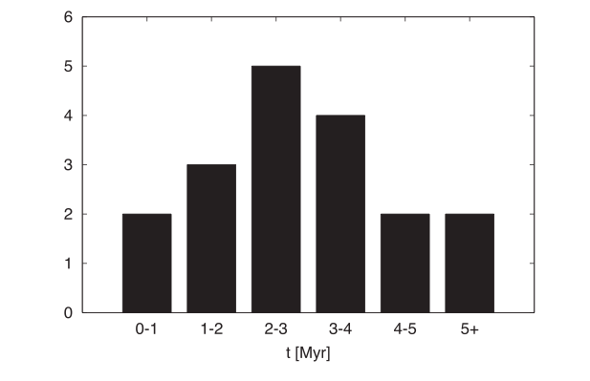
Interaction between the HR8799 resonant chain and an external debris disk
Moore & Quillen 2012
A Neptune mass debris disk can substantially reduce the lifetime of the system.
Number of simulations
lifetime without a debris disk
Lifetimes with a Neptune Mass debris disk

Slide 60
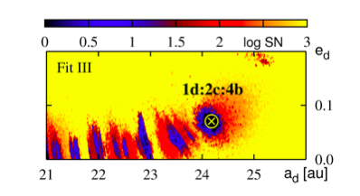
HR 8799 planetary system stability
← stable unstable →
Maximally stable configurations have planets c,d,e in a 1:2:4 resonant configuration
(Gozdziewski & Migaszewski 2009,
Fabrycky & Murray-Clay 2010, Marois et al. 2011)
Gozdziewski &
Migaszewski (2009)
Lifetime of resonant configuration is short (order 10⁷ years)
Planets likely will be ejected from the system (perhaps soon!)
Zone of stability is very small

Slide 61
HR 8799 planetary system stability causes
← stable unstable →
Even though the planets are massive, the stable region is very small so a very small amount of debris affects stability
Gozdziewski &
Migaszewski (2009)
The system is currently observed to be at the boundary of stability. It might be at this boundary because planetesimal mass has pulled it away from the bottom of the resonance

Slide 62
Summary: Kepler 36 Origins
Stochastic migration scenarios to account for Kepler 36’s origin require fine tuning so that planets can bypass 4:3, 5:4, 6:5 resonances and capture into the 7:6 resonance. Stochastic forcing would pull the system out of resonance unless the gas disk is depleted soon after capture
Encounters with planetary embryos can remove two planets from outer resonances allowing them to end up in adjacent orbits like Kepler 36b,c. Impacts with embryos can have high enough velocity and impact angles that the mantle of a planet could be stripped, leaving behind a high density core. This scenario could account for both the proximity of the Kepler 36 planets and their high density contrast

Slide 63
Summary: Constraints on planetesimal disks
KOI-730: Less than a Mars mass of planetesimals could have crossed the orbits of planets, otherwise the 4 planet system would be pulled out of resonance, and planet inclinations increased past those observed
→ A compact Kepler system never interacted with debris after the disk depleted (no solar system shake up)
HR8799: Is near instability, a 1/10th of a planet mass can pull the system out of resonance causing it to fall apart
→Its debris disk (observed) could be responsible for system’s current location at the edge of stability

Slide 64
Not discussed today: Pulling things out of resonance
Tidal force eccentricity damping (Lithwick, Wu, Batygin)
However, pair period distributions not strongly dependent on semi-major axis!

