Slide 1
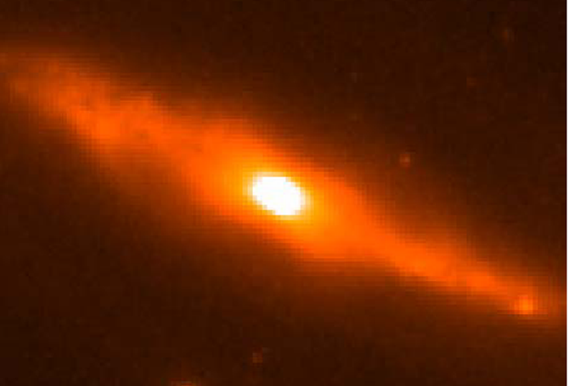
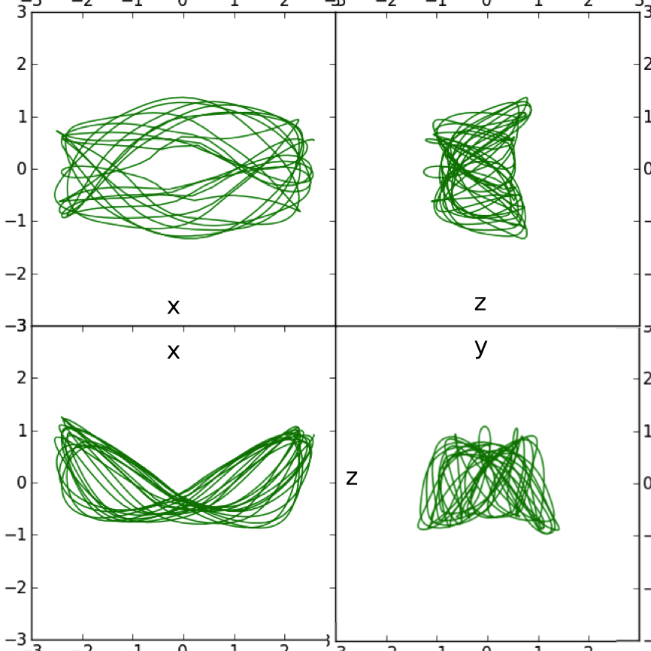
Resonance Heating Model for Peanut- shaped bars
NGC 7582
Alice Quillen
University of Rochester

Slide 2
Motivation
Large scale photometric, spectroscopic and proper motion surveys will measure properties of a billion stars in the Galaxy
How do we make precise measurements for dynamical models?
How do we not only infer current dynamics but also the previous evolution of the Galaxy?

Slide 3
Structure in the velocity distribution of stars in the Solar neighborhood
Stellar velocity distribution in solar neighborhood, Hipparcos
(Dehnen 98)
Coma Berenices group
Hyades stream
Sirius group
Tangential velocity, v
Pleiades group
Hercules stream
Radial velocity, u

Slide 4
Interpreting the U,V plane u=radial v=tangential velocity components in a particular location (solar neighborhood)
E = E_{circular motion} + E_{epicyclic motion}
Coma Berenices group
On the (u,v) plane (r is fixed) the epicyclic amplitude is set by a²~u²/2+v²
The guiding or mean radius is set by v, set by angular momentum, L
Orbit described by a guiding radius and an epicyclic amplitude

Slide 5
uv plane vs orbital elements
mean radius r_{g} (sets L)
epicyclic angle φ
v tangential
circular
orbits
epicyclic amplitude, a
u radial velocity (km/s)

Slide 6
uv plane
mean radius r_{g}
orbits with high angular momentum coming into solar neighborhood from outer galaxy
circular
orbits
angular momentum
orbits with low angular momentum coming into solar neighborhood from inner galaxy
radial velocity

Slide 7
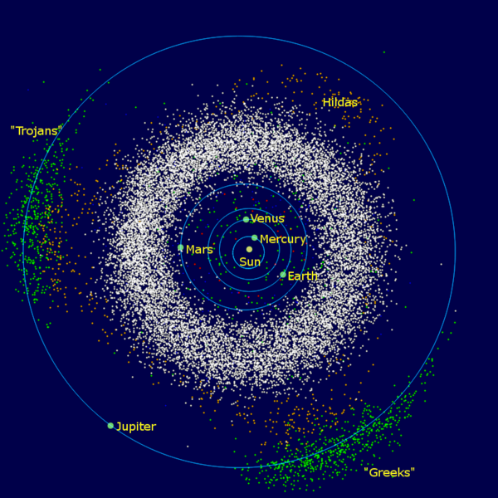
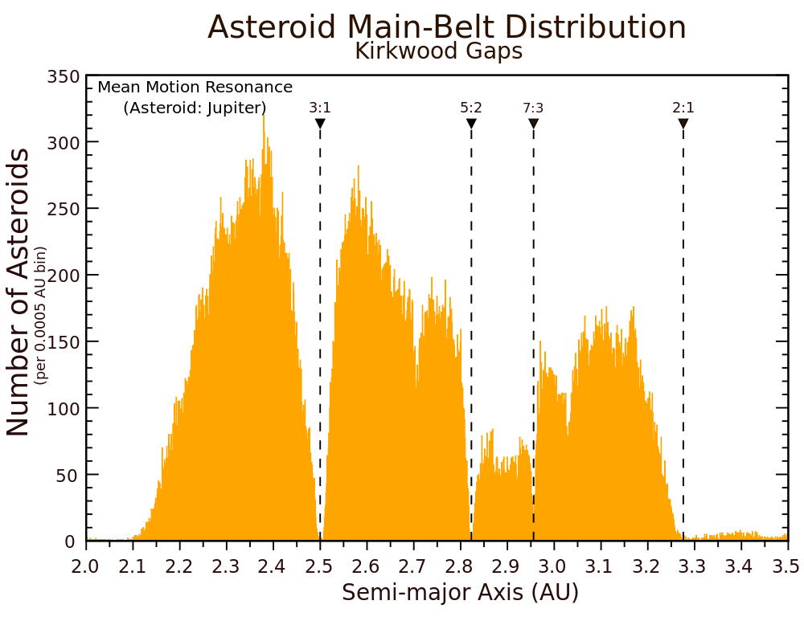
Analogy with Kirkwood gaps
asteroids in the inner solar system
no gaps
gaps!
Sun
Jupiter
Resonant gaps with Jupiter are not clearly seen in radial distribution but are clearly seen in the semi-major axis distribution
Semi-major axis sets orbital period
In the Solar neighborhood the angular momentum (v velocity component) sets the orbital period and so the location of resonances

Slide 8
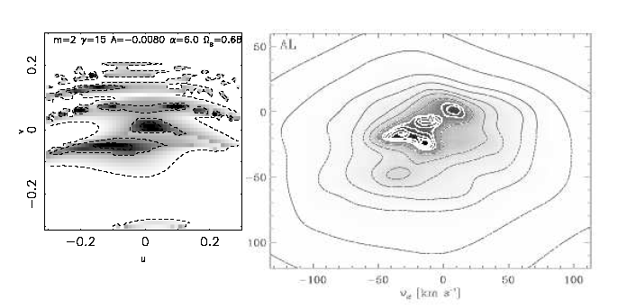
Interpreting the UV plane with resonances
The orbital period is set by v, the tangential velocity component
Resonance with the bar is crossed
Gap due to Outer Lindblad resonance with Bar (e.g., Dehnen 2000)
Analogy in celestial mechanics: the orbital period is set by the semi-major axis
Hipparcos velocity distribution
tangential velocity v
Hercules stream
Radial velocity, u

Slide 9
Directions correspond to points in the uv plane
In this neighborhood there are two different velocity vectors
At the resonant period, orbits are divided into two families
There are no orbits with intermediate velocity vectors
bar
tangential velocity v
Hercules stream
Bifurcation of periodic orbit families by the Lindblad resonance
Radial velocity u

Slide 10
Precision measurements
Lindblad resonance is a commensurability
Two radial oscillations per orbit in the bar frame
Resonances are narrow (scales with perturbation strength)
Tight constraints from their location
Gardner & Flynn 2010, Minchev et al. 2007 measured the Bar pattern speed
bar

Slide 11
Location of resonances in different neighborhoods
Inside the solar neighborhood
closer to the 2:1 Lindblad resonance
Outside the solar neighborhood
more distant from the resonance
→ There should be a shift in the location of the gap dividing the Hercules stream from the rest of the distribution

Slide 12
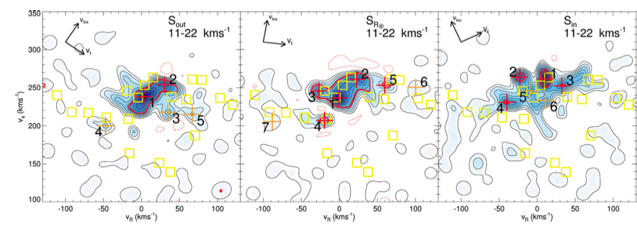
Local Velocity Distributions show a shift in the location of the gap
at larger radius
solar neighborhood
at smaller radius
Tangential velocity v
RAVE data
Antoja et al. (2012)
Radial velocity u

Slide 13
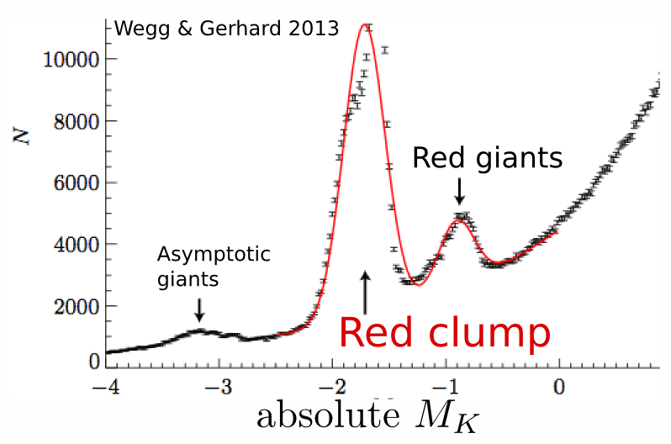
3D structure of the Milky Way Bulge
Photometric surveys of the Galactic bulge
Deconvolving luminosity distributions at different positions on the sky
each panel at a different latitude
10
5kpc
Using VVV survey (like 2MASS only deeper) Wegg & Gerhard 2013

Slide 14
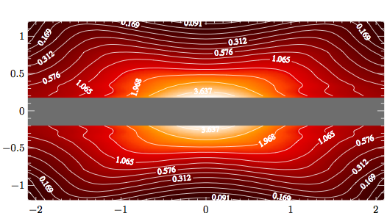
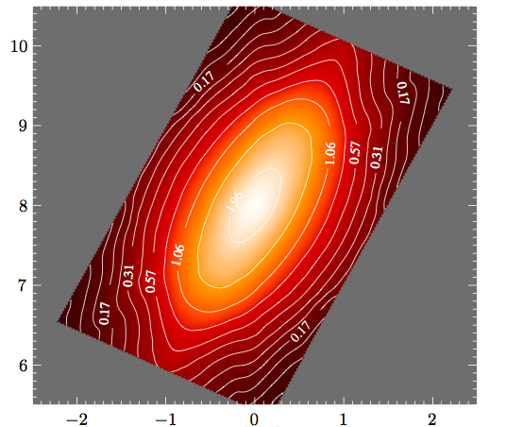
Milky Way not only barred but has an X- or peanut-shaped bulge
from the side
3D Models of the Milky Way bulge by
Wegg & Gerhard 2013
z(kpc)
from the side
x (kpc)
y (kpc)
from above
x(kpc)

Slide 15
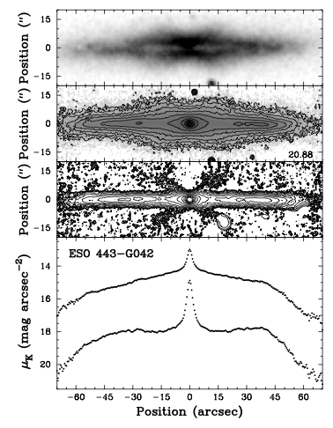
X- or peanut shaped bulges often seen in edge-on spiral galaxies
Recent photometric surveys (VVV, OGLE III) allow improved mapping of structure of the Milky Way
Discovery of X- or peanut shaped bulge in the Galaxy (Nataf et al. 2010, Williams & Zoccalli 2010)
Use of Red clump as a distance indicator (Stanek et al. 1994)
Bureau et al. 06

Slide 16
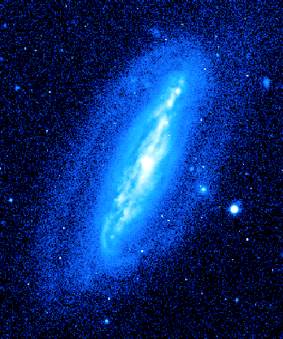
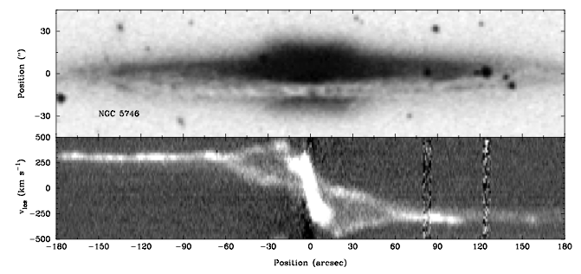
In rare inclined cases both bar and peanut
are seen NGC7582
(Quillen et al. 1997)
NGC 7582
B band
Velocities measured spectroscopically imply that all peanut-shaped galaxies are barred (Martin Bureau’s 98 thesis)
→ Peanut shape is a barred galaxy phenomenon
K band
isophotes
Bureau ‘98
velocity position
spectrum

Slide 17
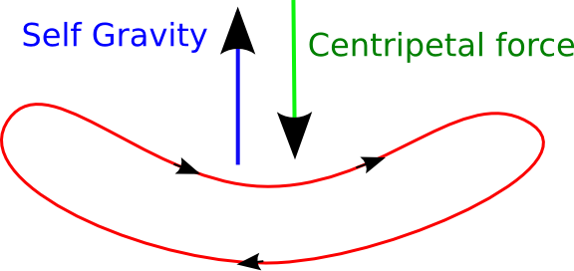
Bar Buckling Instability
Firehose instability
Fridman, & Polyachenko (1984)
Raha et al. (1991)

Slide 18
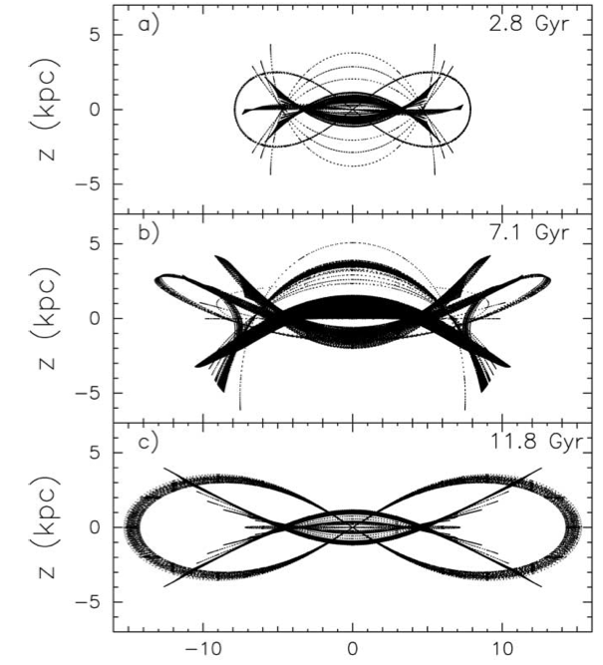
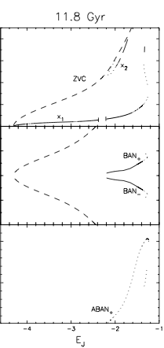
3D Orbit families
Banana shaped periodic orbits
2:1 Vertical resonance
Combes et al. 90, Pfenniger et al. 91
periodic orbit families
Martinez-Valpuesta et al. 06
Jacobi integral
Martinez-Valpuesta et al. 06

Slide 19
N-body simulations (GALMER database)

Slide 20
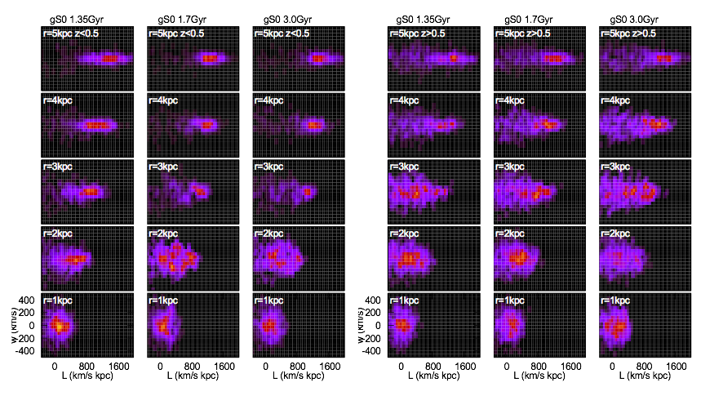
Local Velocity distributions
z<0.5 kpc
measured in N-body simulation
z>0.5 kpc
radius →
angular momentum →
angular momentum →

Slide 21
What do we seen in simulations?
Bars slow down
Some bars buckle, others do not
Peanut-shape keeps growing after bar buckling phase – while galaxy is vertically symmetric
Within a particular angular momentum value, stars are heated vertically
Absence of cold populations within boundary (heating, not resonance trapping)
Resonance is more important than previous bar buckling
(though bar buckling can increase disk thickness and so decrease the vertical oscillation frequency)

Slide 22
Vertical resonance
Commensurability between vertical oscillations and rotation in frame of bar
Vertical 2:1 Lindblad resonance
Integrate this
resonant angle
Fixed for periodic orbits
Banana shaped orbits
BAN+
BAN-

Slide 23
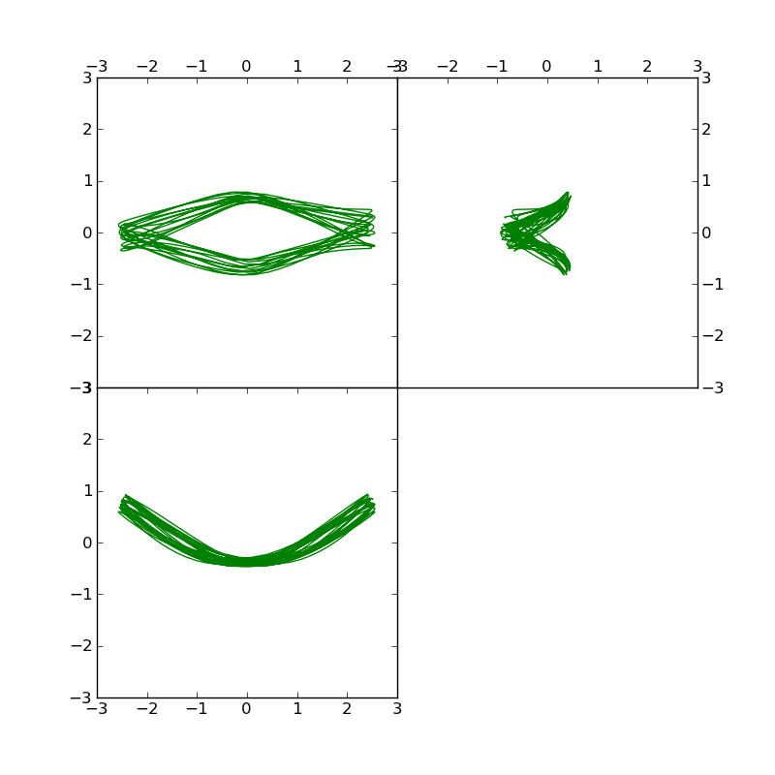
Nearly periodic orbits
xy
yz
y
y
x
z
xz
Figure by Yu-Jing Qin
BAN+
z
x

Slide 24
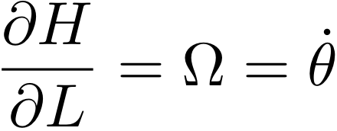
Hamiltonian Model for an axi-symmetric system
epicyclic frequency
vertical frequency
angular rotation rate
rotation
Hamilton’s equations
epicyclic motion
vertical motion
Hamiltonian is independent of angles → L,J_{r}, J_{z} conserved
With a better approximation H₀ depends on J_{r}², J_{z}², J_{z}J_{r}

Slide 25
Relation between action/angle variables and Cartesian coordinates
J_{z} is a vertical oscillation amplitude
Orbit inclination and maximum height of orbit above disk mid-plane) depends on J_{z}
→ p_{z}
→ z

Slide 26
Potential perturbation in action angle variables
m=4 Fourier component
resonant angle
perturbation proportional to J, similar to a second order mean motion resonance

Slide 27
Hamiltonian model near resonance
from unperturbed Hamiltonian
bar perturbation
distance to resonance
a frequency that
depends on radius
resonant angle
bar strength
Fourier components with fast angles can be neglected via averaging
Hamiltonian then only contains one angle, so can perform a canonical transformation and reduce to a one dimensional system

Slide 28
Vertical resonances with a bar
Orbits in the plane
Increasing radius
Banana shaped periodic orbits
Level curves of Hamiltonian in a canonical coordinate system with
orbits in midplane are near the origin
Orbits in the plane

Slide 29
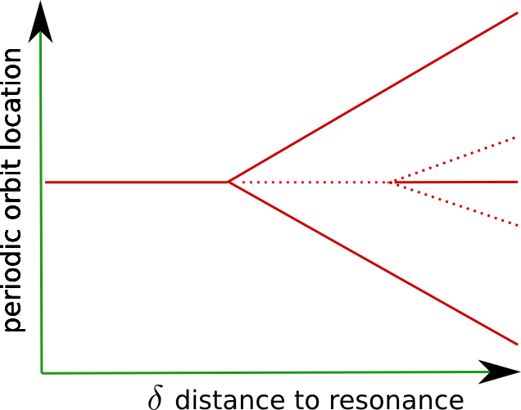
Bifurcation of periodic orbits
Martinez-Valpuesta et al. 06
Jacobi integral

Slide 30
As the bar grows, stars are lifted Resonance trapping
Growing bar
Extent stars are lifted depends on the initial radius (Quillen 2002)
Depends on width of resonance
There are no planar orbits in resonance

Slide 31
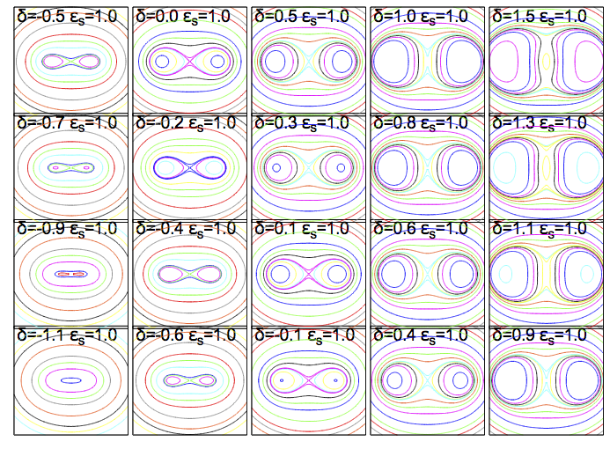
Bar slowing or disk thickening
time →
radius →

Slide 32
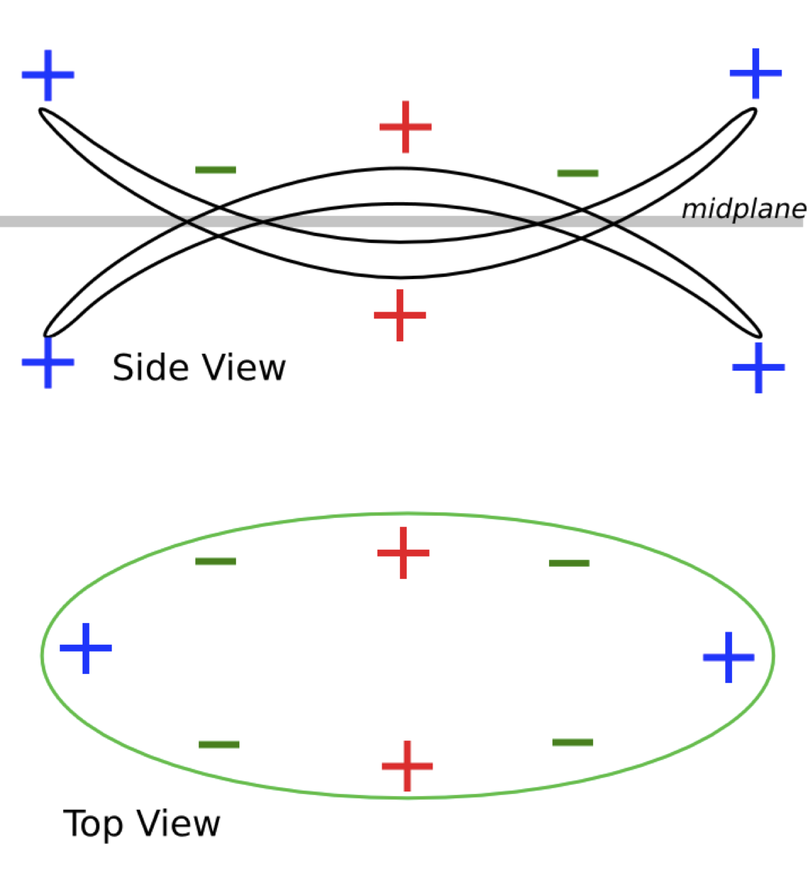
Which Fourier component is relevant?
If the galaxy is symmetrical about the midplane, the m=4 component excites the 2:1 vertical resonance

Slide 33
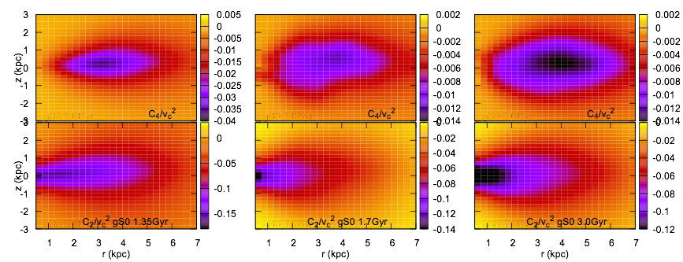
Fourier components of gravitational potential m=2,4 As a function of z, measured from the simulation
m=4
m=4
m=4
z (kpc)
m=2
m=2
m=2
r (kpc)
early bar buckling after bar buckling

Slide 34
Testing the model
Fit axi-symmetric potential in mid-plane
derive rotation curve (gives Ω, κ)
Fit axi-symmetric potential as a function of z
estimate vertical oscillation frequency ν
estimate a coefficient
Use rotation curve, ν and bar pattern speed to compute distance to resonance δ
Fit m=4 Fourier component as a function of z²
estimate ε coefficient
All coefficients are a function of radius (or mean angular momentum)

Slide 35
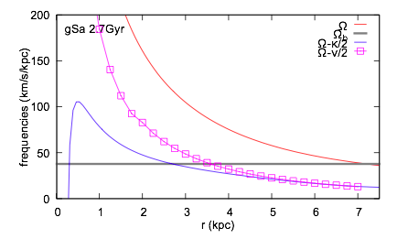
Vertical Resonance is near location of peanut
vertical resonance
bar pattern
Lindblad resonance is not on top of the vertical resonance

Slide 36
Hamiltonian model gives estimates for resonance width, libration frequency, height of periodic orbits
Resonance strong primarily where |δ| < |ε|
Libration frequency |ε| (defines adiabatic limit)
separatrix orbit

Slide 37
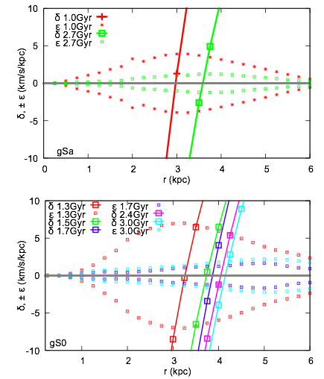
Resonance is narrow and moves outwards
Resonance trapping model dies
distance to resonance
resonant width
distance to resonance
distance to resonance
resonant width

Slide 38
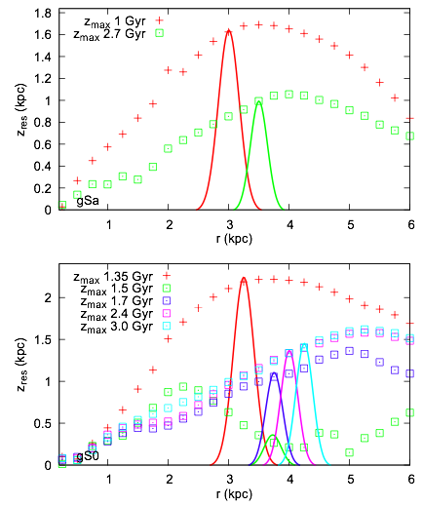
Height of orbits
Predicted heights of orbits in separatrix are approximately the right size!

Slide 39
Fate of stars exterior to resonance
As the bar slows down, stars stars originally in midplane are pushed into resonance
These are lifted into orbits near the resonance separatrix
Then they cross the separatrix but remain at high inclination
Only stars in orbits near the separatrix will be aligned with the bar and “support the peanut shape”
These are not near periodic orbits!
→ Resonant heating process

Slide 40
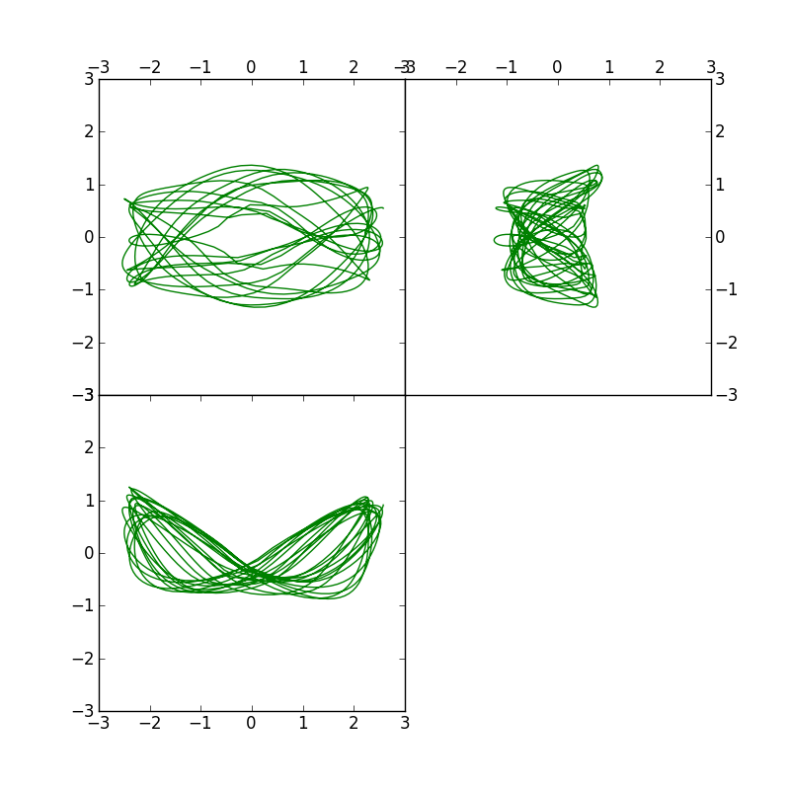
Orbits with libration near the separatrix
x →
z →
xy
yz
y
y
Figure by Yujing Qin
x →
xz
z
These are the only orbits that would support the peanut shape
resonant angle varies
x

Slide 41
Is the X-shaped feature at the location of the resonance in the Milky Way?
We don’t know ν, so using density instead
Poisson’s equation in cylindrical coordinates
In midplane
Use the resonance commensurability
Expression for midplane density as a function of rotation curve and bar pattern speed. Should be equal to the actual midplane density in resonance
→ Constraint on mid-plane density at the location of the resonance

Slide 42
Gripe about Milky Way models
And I thank Sanjib Sharma for adding routines to Galaxia and computing the midplane density and rotation curve for the Besançon mass model

Slide 43
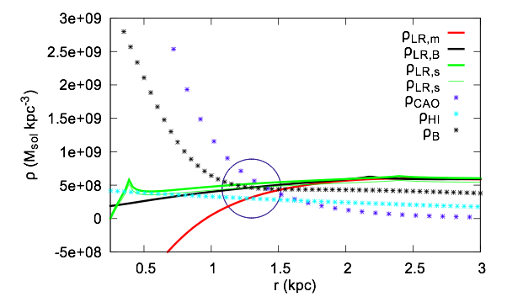
X in Milky Way, rotation curve, bar pattern speed, density estimates all self-consistent
Malhotra’s rotation curve
Besançon model rotation curve
Sofue’s rotation curve
Cao’s model
Malhotra’s HI dispersions
Besançon model density
future work can shrink this error circle

Slide 44
Metallicity of stars in the X
Stars in X-shape should be disk stars
They should have metallicity similar to disk just exterior to resonance

Slide 45
Summary
Peanut/X shape is caused by outward motion of the m=2 vertical resonance.
Independent of bar buckling
Peanut ends approximately at location of resonance
Hamiltonian model created for the resonance.
X/Peanut-shape due to stars in vicinity of separatrix. Resonance heating model
Height of orbits approximately consistent with that predicted from the Hamiltonian model using coefficients measured from simulations
Mid-plane density, bar pattern, rotation curve all self-consistent with location of resonance in Milky Way

Slide 46
What next ….
Radial degree of freedom
VVV model can now be used to compute Fourier components of potential for the Milky Way bar
Can we tell if the bar buckled?
Can we tell if or how far the bar pattern speed varied?
Self-consistency → constraints
Thanks to: Ivan Minchev, Paola di Matteo, Yu-Jing Qin,
Sanjib Sharma, David Nataf, Juntai Shen

